Slide 1
Supervised2 Linear regression
資料科學 Data Science
張家銘 Jia-Ming Chang
政治大學資訊科學系/NCCU.CS
The slide isonly for educational purposes. If any infringement, please contact me, we will correct immediately.

Slide 2
Copyright declaration 版權說明
Some of the figures in this presentation are taken from "An Introduction to Statistical Learning, with applications in R" (Springer, 2013) with permission from the authors: G. James, D. Witten, T. Hastie and R. Tibshirani.
The web site of the book
The credit of individual is indicated in the bottom part of the slide.
ie.,

Slide 3
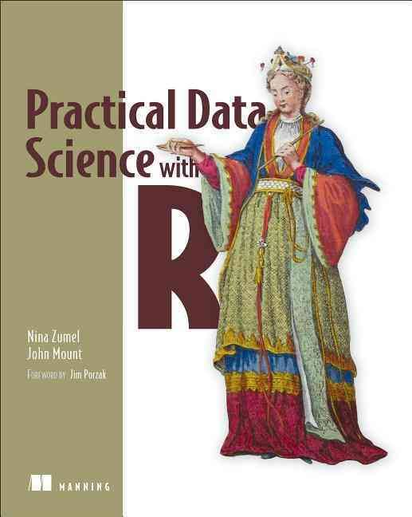
Copyright declaration 版權說明
Some of the figures in this presentation are taken from "Practical Data Science with R (Manning, 2019)”
The web site of the book
The credit of individual is indicated in the bottom part of the slide.
ie.,

Slide 4
Copyright declaration 版權說明
Some of the figures in this presentation are taken from "R for Data Science” under the Creative Commons Attribution-NonCommercial-NoDerivs 3.0 License.
The web site of the book
The credit of individual is indicated in the bottom part.
ie.,

Slide 5
Recap for the last week

Slide 6
Memorization methods
Building single-variable models
Cross-validated variable selection
Building basic multivariable models
nearest neighbor
naive Bayes
Practical Data Science with R by Nina Zumel, John Mount

Slide 7
Building single-variable models
Using categorical features
Using numeric features

Slide 8
Building single-variable models - Using categorical features

Slide 9
Take Var218 as example
pPos <- sum(outCol==pos)/length(outCol)
naTab <- table(as.factor(outCol[is.na(varCol)]))
pPosWna <- (naTab/sum(naTab))[pos]
vTab <- table(as.factor(outCol),varCol)
pPosWv <- (vTab[pos,]+1.0e-3*pPos)/(colSums(vTab)+1.0e-3)
pred <- pPosWv[appCol]
pred[is.na(appCol)] <- pPosWna
pred[is.na(pred)] <- pPos
Practical Data Science with R by Nina Zumel, John Mount

Slide 10
Function to build single-variable models for categorical variables
mkPredC <- function(outCol,varCol,appCol) {
pPos <- sum(outCol==pos)/length(outCol)
naTab <- table(as.factor(outCol[is.na(varCol)]))
pPosWna <- (naTab/sum(naTab))[pos]
vTab <- table(as.factor(outCol),varCol)
pPosWv <- (vTab[pos,]+1.0e-3*pPos)/(colSums(vTab)+1.0e-3)
pred <- pPosWv[appCol]
pred[is.na(appCol)] <- pPosWna
pred[is.na(pred)] <- pPos
pred
}
Practical Data Science with R by Nina Zumel, John Mount

Slide 11
Building single-variable models - Using numeric features

Slide 12
Take Var7 as example
v<-"Var7"
outCol<-dTrain[,outcome]
varCol<-dTrain[,v]
appCol<-dTrain[,v]
cuts <- unique(as.numeric(quantile(varCol,
probs=seq(0, 1, 0.1),na.rm=T)))
varC <- cut(varCol,cuts)
appC <- cut(appCol,cuts)
mkPredC(outCol,varC,appC)

Slide 13
Using cross-validation to estimate effects of overfitting
var <- 'Var217'
aucs <- rep(0,100)
for(rep in 1:length(aucs)) {
useForCalRep <- rbinom(n=dim(dTrainAll)[[1]],size=1,prob=0.1)>0
predRep <- mkPredC(dTrainAll[!useForCalRep,outcome],
dTrainAll[!useForCalRep,var],
dTrainAll[useForCalRep,var])
aucs[rep] <- calcAUC(predRep,dTrainAll[useForCalRep,outcome])
}
mean(aucs)
sd(aucs)
Practical Data Science with R by Nina Zumel, John Mount

Slide 14
Using cross-validation to estimate effects of overfitting
without for() loop
fCross <- function() {
useForCalRep <- rbinom(n=dim(dTrainAll)[[1]],size=1,prob=0.1)>0
predRep <- mkPredC(dTrainAll[!useForCalRep,outcome],
dTrainAll[!useForCalRep,var],
dTrainAll[useForCalRep,var])
calcAUC(predRep,dTrainAll[useForCalRep,outcome])
}
aucs <- replicate(100,fCross())
Practical Data Science with R by Nina Zumel, John Mount

Slide 15
Building models using many variables
k-nearest neighbor
Naive Bayes
decision trees : Supervised learning - random forest

Slide 16
Building models using many variables - Naive Bayes

Slide 17
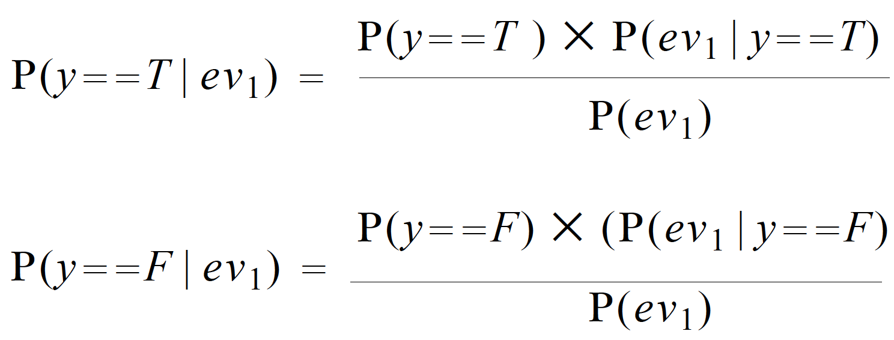
Bayes’ law
Practical Data Science with R by Nina Zumel, John Mount

Slide 18
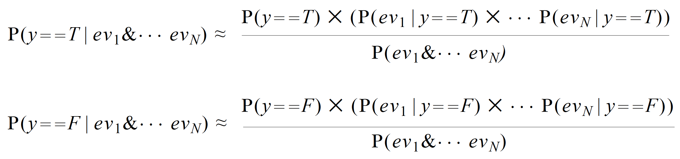
Naive Bayes assumption
P(y==T|evidence) + P(y==F|evidence) = 1
Practical Data Science with R by Nina Zumel, John Mount

Slide 19
Naive Bayes
For numerical reasons, it’s better to convert the products into sums,
Practical Data Science with R by Nina Zumel, John Mount

Slide 20
Building models using many variables - k-nearest neighbor

Slide 21
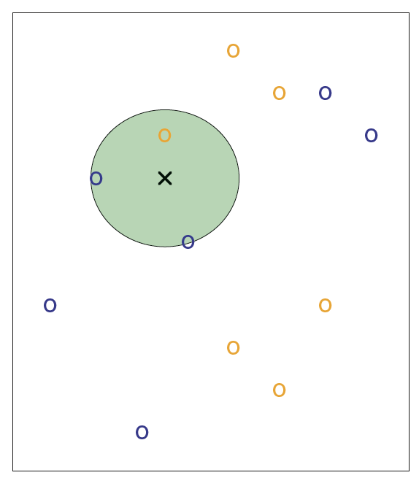
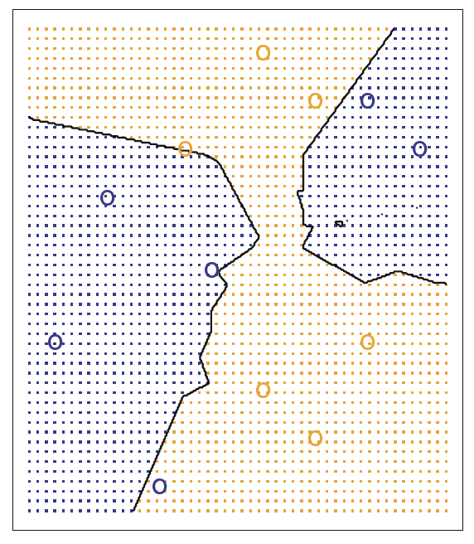
K=3
Figure2.14, An Introduction to Statistical Learning with Applications in R by Gareth James, Daniela Witten, Trevor Hastie, Robert Tibshirani

Slide 22
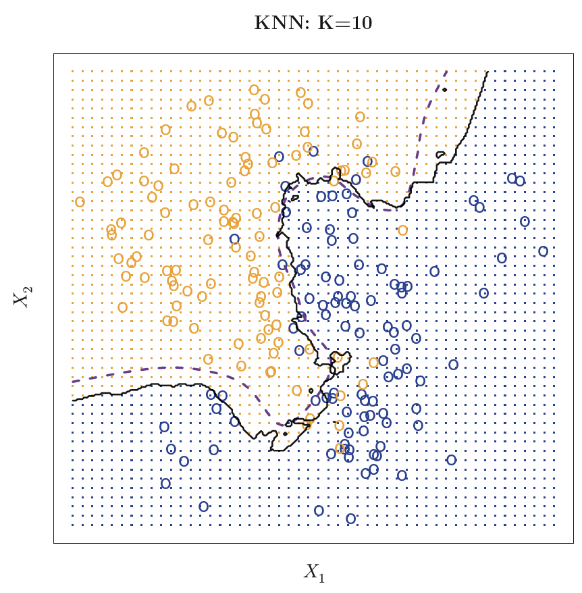
Simulation data by K=10
error rate
KNN:0. 1363
Bayes: 0. 1304
Figure2.15, An Introduction to Statistical Learning with Applications in R by Gareth James, Daniela Witten, Trevor Hastie, Robert Tibshirani

Slide 23
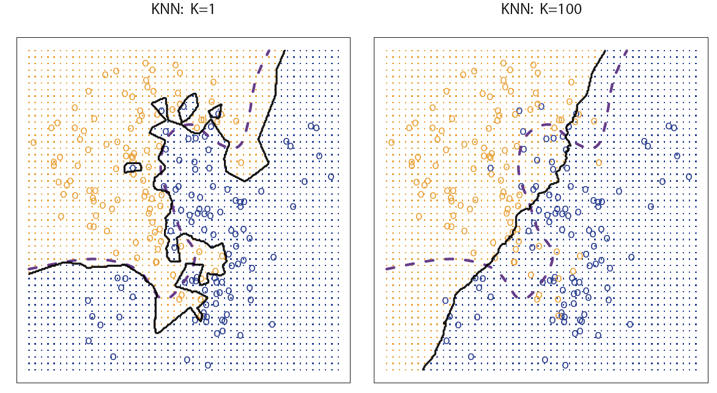
The bigger K, the better?
error= 0. 1695
error= 0. 1925
low-bias but very high-variance
low-variance but high-bias
Figure2.16, An Introduction to Statistical Learning with Applications in R by Gareth James, Daniela Witten, Trevor Hastie, Robert Tibshirani6

Slide 24
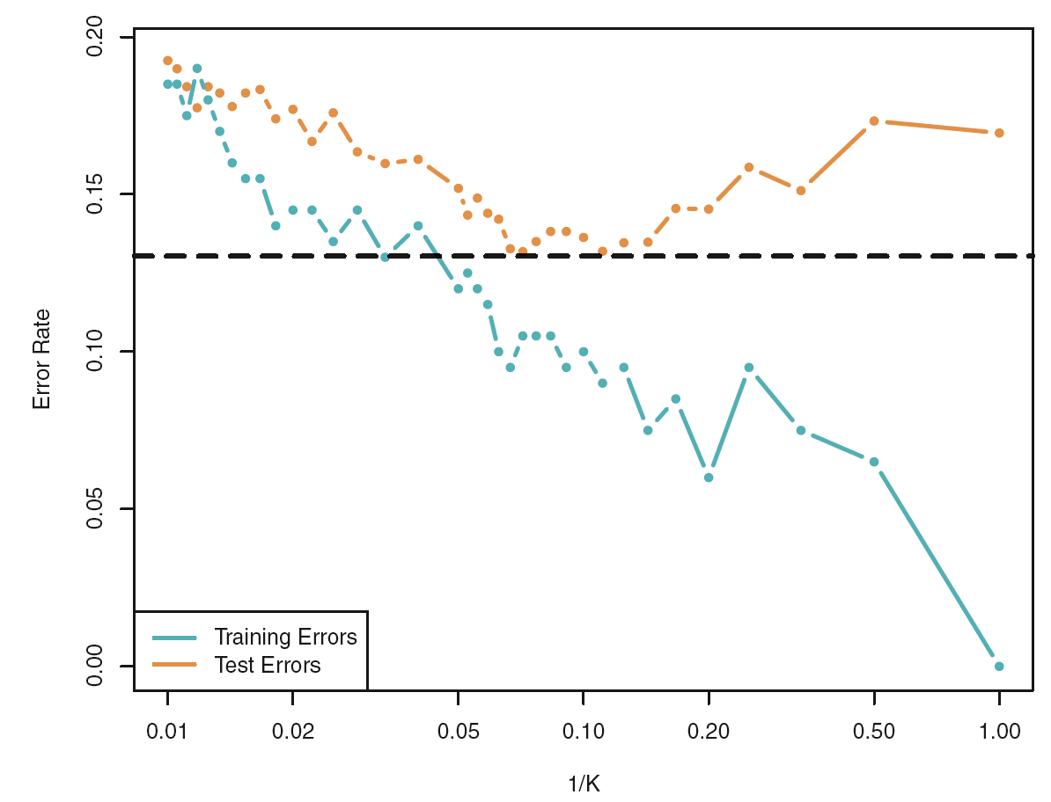
Figure2.17, An Introduction to Statistical Learning with Applications in R by Gareth James, Daniela Witten, Trevor Hastie, Robert Tibshirani

Slide 25
Using nearest neighbor methods
events with unbalanced outcomes (that probabilities not near 50%)
using a large k so KNN can express a useful range of probabilities
have a good chance of seeing 10 positive examples in each neighborhood
10/0.07 = 142
Practical Data Science with R by Nina Zumel, John Mount

Slide 26
Single-variable model
Single-variable models can be thought of as being simple summaries of the training data (categorical variables)
=> the model is essentially a contingency table or pivot table
Practical Data Science with R by Nina Zumel, John Mount

Slide 27
Naive Bayes
form their decision by building a large collection of independent single-variable models
Prediction for a given example is just the product of all the applicable single variable model adjustments => sums of appropriate summaries of the original training data.
Naive Bayes doesn’t perform any clever optimization, so it can be outperformed by methods like logistic regression and support vector machines.
Practical Data Science with R by Nina Zumel, John Mount

Slide 28
K-nearest neighbor
summaries of the k pieces of training data that are closest to the example to be scored.
KNN models usually store all of their original training data instead of an efficient summary
=> they truly do memorize the training data
Practical Data Science with R by Nina Zumel, John Mount

Slide 29
Chp. 7: Linear and logistic regression
3. Linear regression

Slide 30
Linear and logistic regression
Extracting relations and advice from functional models
linear regression
predict quantities
Interpreting the diagnostics from lm call
logistic regression
predict probabilities or categories
Interpreting the diagnostics from glm call
Practical Data Science with R by Nina Zumel, John Mount

Slide 31
Linear and logistic regression
This class of methods is especially useful when you don’t just want to predict an outcome, but you also want to know the relationship between the input variables and the outcome.
This knowledge can prove useful because this relationship can often be used as advice on how to get the outcome that you want.
Practical Data Science with R by Nina Zumel, John Mount

Slide 32
Linear regression

Slide 33
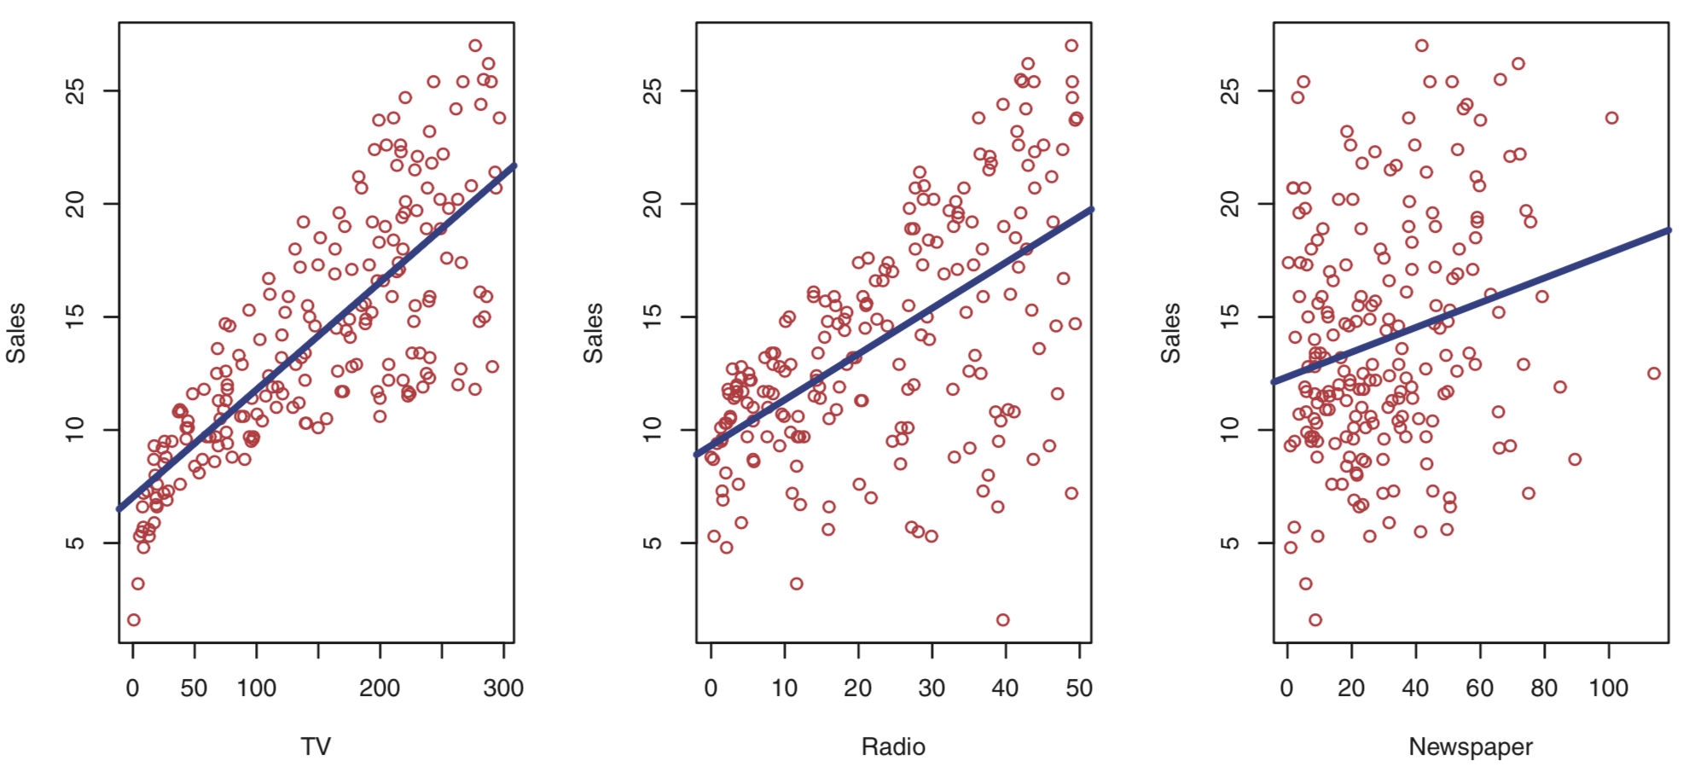
Figure 2.1, p16, An Introduction to Statistical Learning, with applications in R" (Springer, 2013) with permission from the authors: G. James, D. Witten, T. Hastie and R. Tibshirani

Slide 34
Is there a relationship between advertising budget and sales?
How strong is the relationship between advertising budget and sales?
Which media contribute to sales?
How accurately can we estimate the effect of each medium on sales?
How accurately can we predict future sales?
Is the relationship linear?
Is there synergy (interaction) among the advertising media?
$50,000 on television + $50,000 on radio >= $100,000 to either television or radio individually?
An Introduction to Statistical Learning with Applications in R by Gareth James, Daniela Witten, Trevor Hastie, Robert Tibshirani

Slide 35
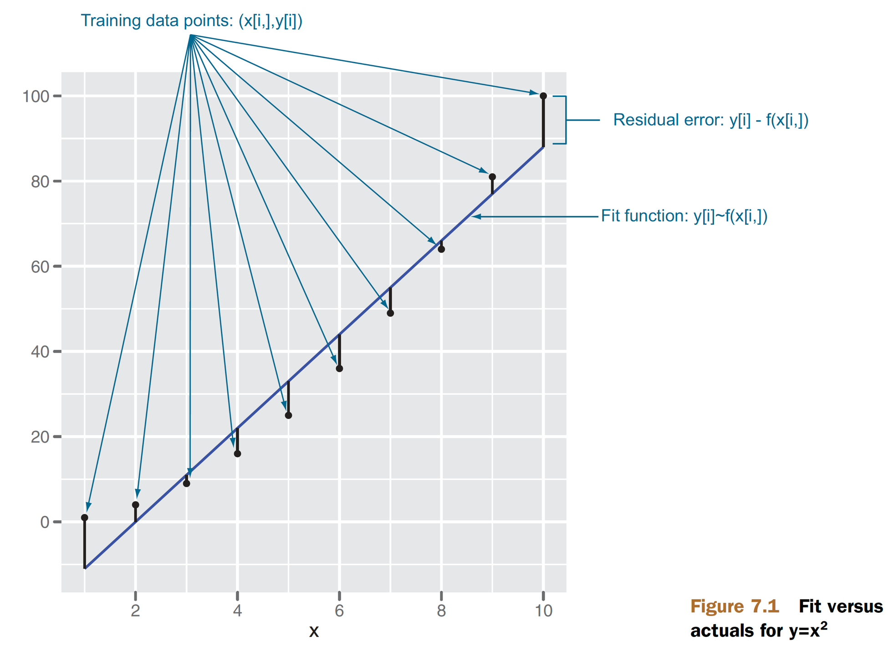
How linear regression is used in the field?
we’re using a linear model to predict something that is itself not linear.
Figure7.1, p143, Practical Data Science with R by Nina Zumel, John Mount

Slide 36
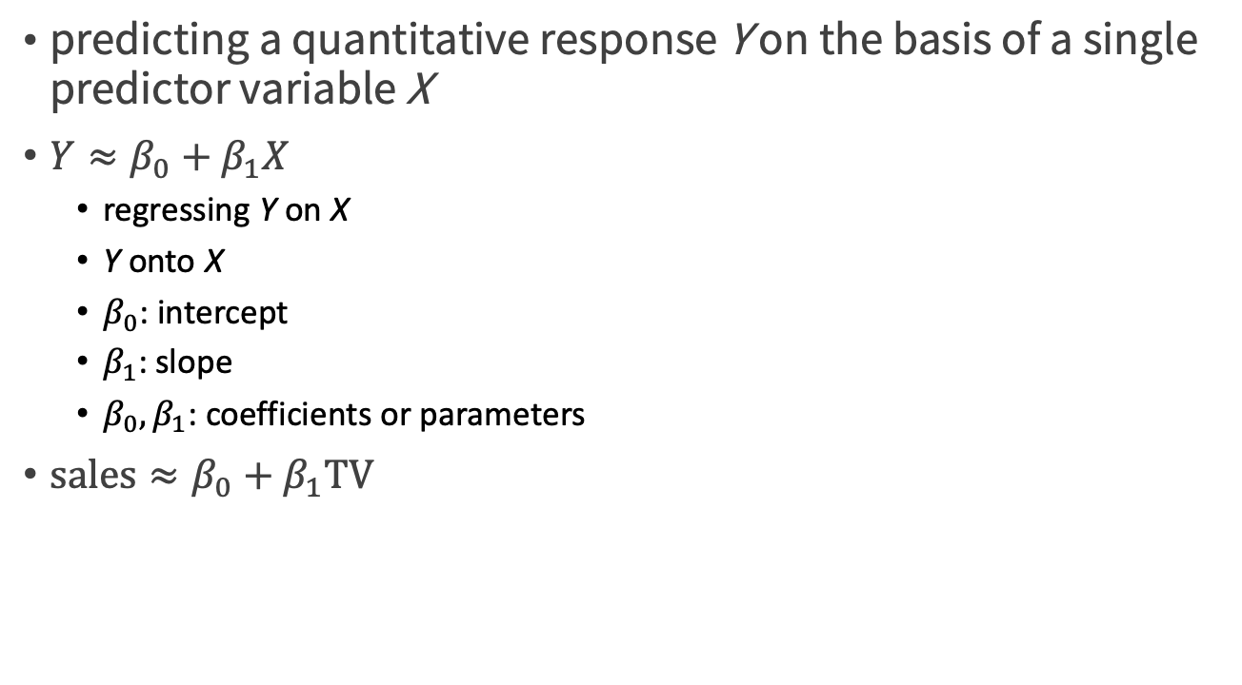
Simple Linear Regression
predicting a quantitative response Y on the basis of a single predictor variable X
$Y≈β_{0}+β_{1}X$
regressing Y on X
Y onto X
$β_{0}$: intercept
$β_{1}$: slope
$β_{0},β_{1}$: coefficients or parameters
$\text{sales}≈β_{0}+β_{1}\text{TV}$
An Introduction to Statistical Learning with Applications in R by Gareth James, Daniela Witten, Trevor Hastie, Robert Tibshirani

Slide 37
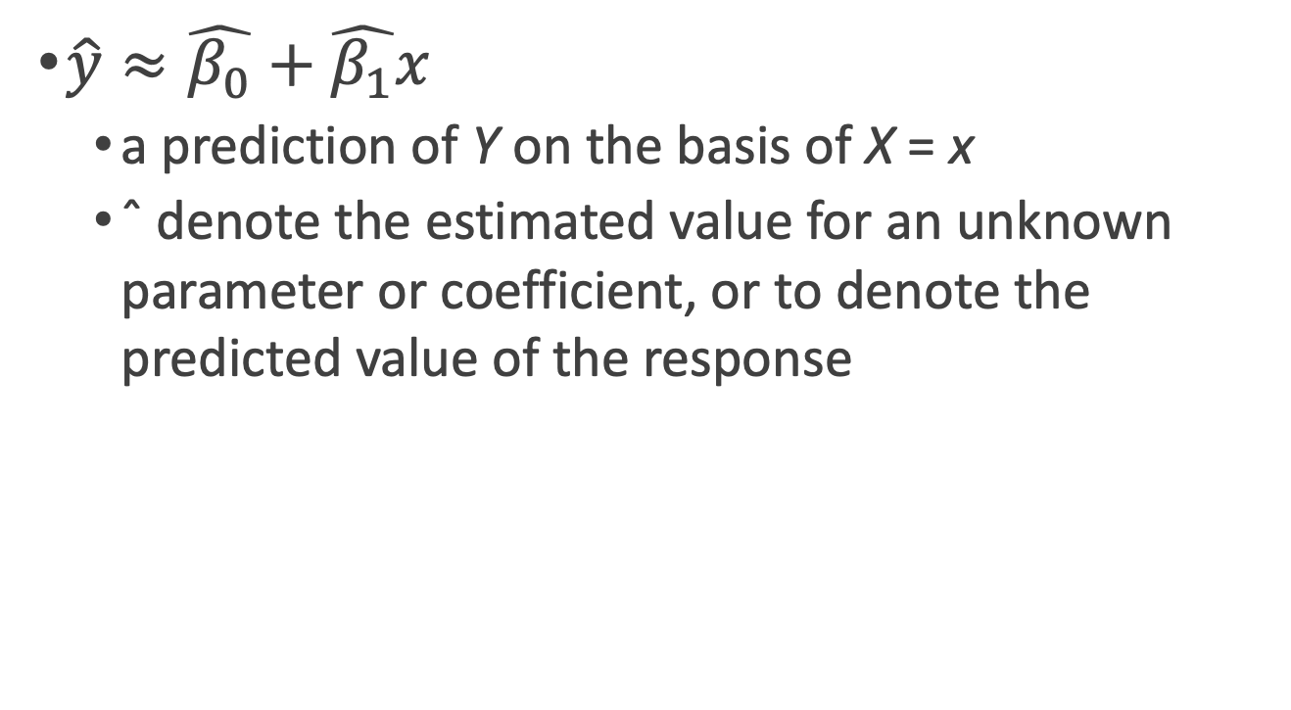
Simple Linear Regression
$\hat{y}≈\hat{β_{0}}+\hat{β_{1}}x$
a prediction of Y on the basis of X = x
ˆ denote the estimated value for an unknown parameter or coefficient, or to denote the predicted value of the response
An Introduction to Statistical Learning with Applications in R by Gareth James, Daniela Witten, Trevor Hastie, Robert Tibshirani

Slide 38
Linear regression
for every person i , we want to predict pounds.lost[i] based on daily.cals[i] and daily.exercise[i]
pounds.lost[i] = b.cals * daily.cals[i] + b.exercise * daily.exercise[i]
pounds.lost : dependent, response variable
daily.cals, daily.exercise : independent, explanatory variables
b.cals, b.exercise : coefficients, betas
Practical Data Science with R by Nina Zumel, John Mount

Slide 39
Estimating the Coefficients
y[i] ~ f(x[i,]) = b[1] x[i,1] + b[2] x[i,2] + ... b[n] x[i,n] + e[i]
We want numbers b[1],...,b[n] (called the coefficients or betas ) such that f(x[i,]) is as near as possible to y[i] for all (x[i,],y[i]) pairs in our training data.
e[i] : unsystematic errors
average to 0
uncorrelated with x[i,] and y[i] .
Practical Data Science with R by Nina Zumel, John Mount

Slide 40
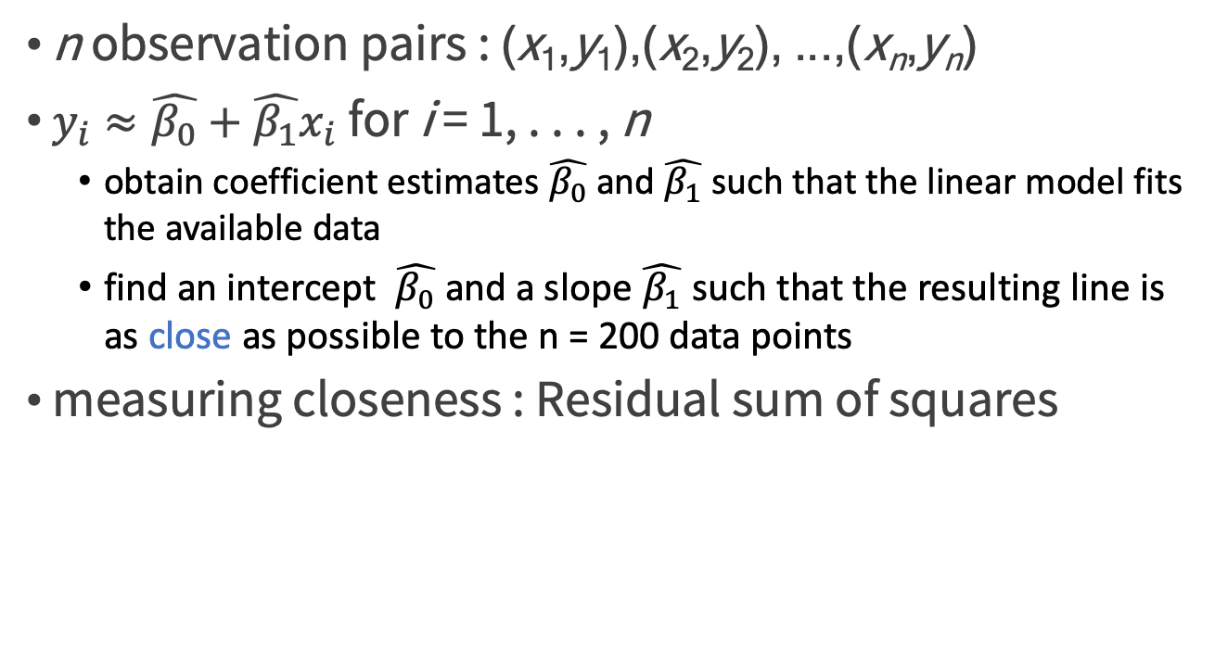
Estimating the Coefficients
n observation pairs : (x₁,y₁),(x₂,y₂), ...,(x_{n},y_{n})
$y_{i}≈\hat{β_{0}}+\hat{β_{1}}x_{i}$for i = 1, . . . , n
obtain coefficient estimates $\hat{β_{0}}$ and $\hat{β_{1}}$ such that the linear model fits the available data
find an intercept $\hat{β_{0}}$ and a slope $\hat{β_{1}}$ such that the resulting line is as close as possible to the n = 200 data points
measuring closeness : Residual sum of squares
Practical Data Science with R by Nina Zumel, John Mount

Slide 41
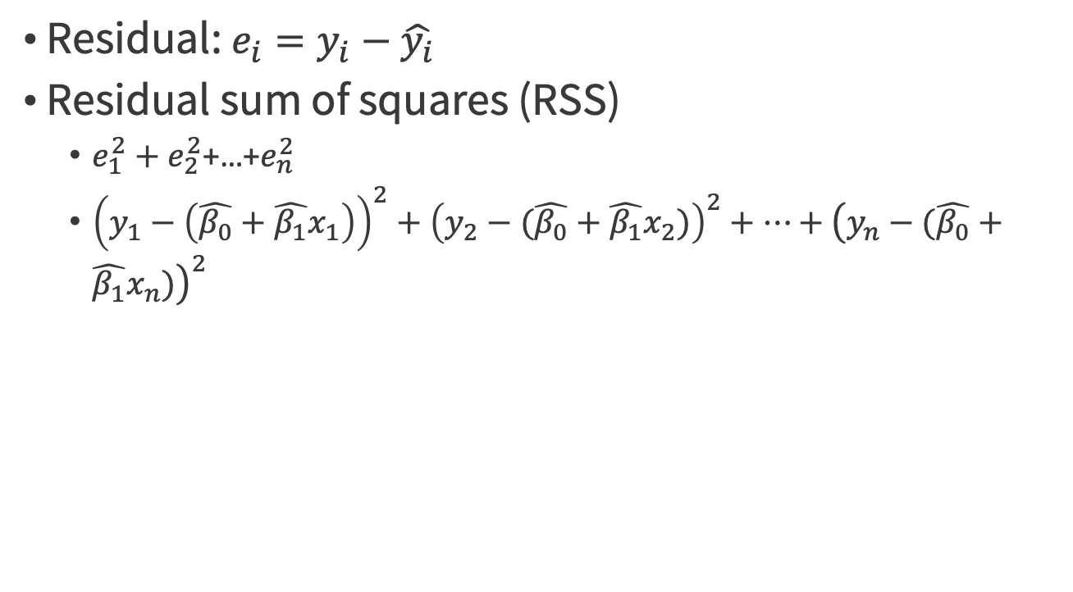
Residual sum of squares (RSS)
Residual: $e_{i}=y_{i}−\hat{y_{i}}$
Residual sum of squares (RSS)
$e_{1}^{2}+e_{2}^{2}$+…+$e_{n}^{2}$
${\left(y_{1}−\left(\hat{β_{0}}+\hat{β_{1}}x_{1}\right)\right)}^{2}+{\left(y_{2}−(\hat{β_{0}}+\hat{β_{1}}x_{2})\right)}^{2}+…+{\left(y_{n}−(\hat{β_{0}}+\hat{β_{1}}x_{n})\right)}^{2}$
An Introduction to Statistical Learning with Applications in R by Gareth James, Daniela Witten, Trevor Hastie, Robert Tibshirani

Slide 42
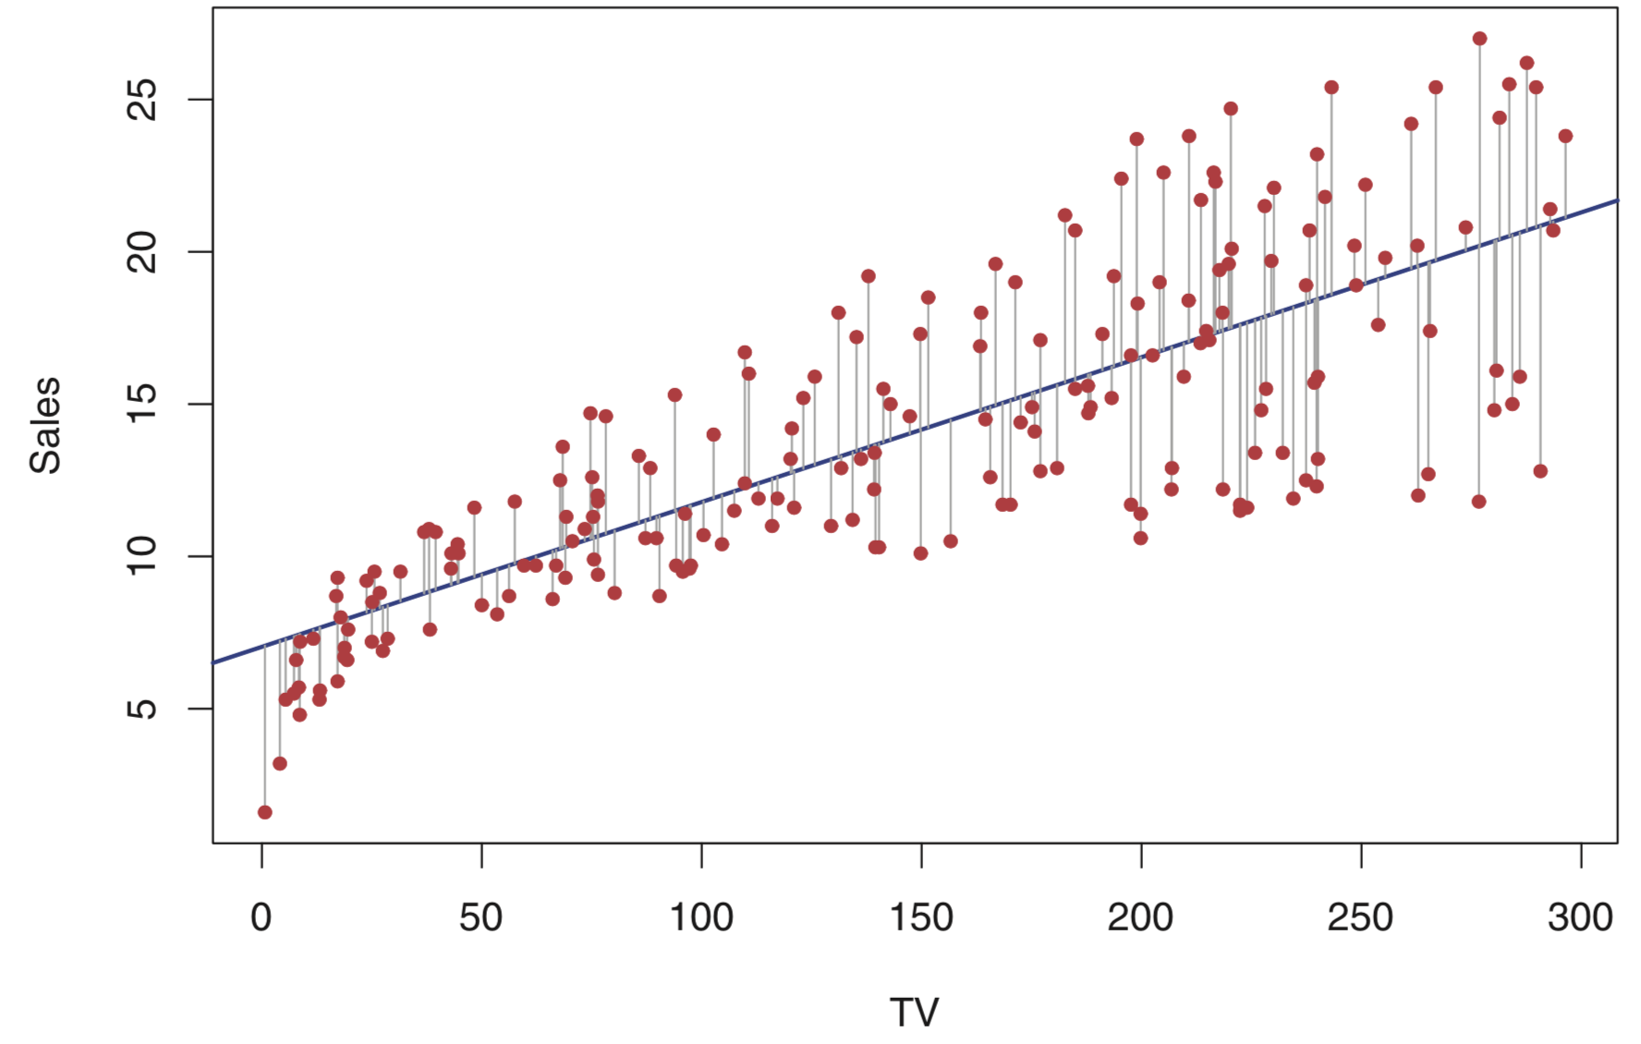
the least squares fit for the regression of sales onto TV
Figure 3.1, p62, An Introduction to Statistical Learning, with applications in R" (Springer, 2013) with permission from the authors: G. James, D. Witten, T. Hastie and R. Tibshirani

Slide 43
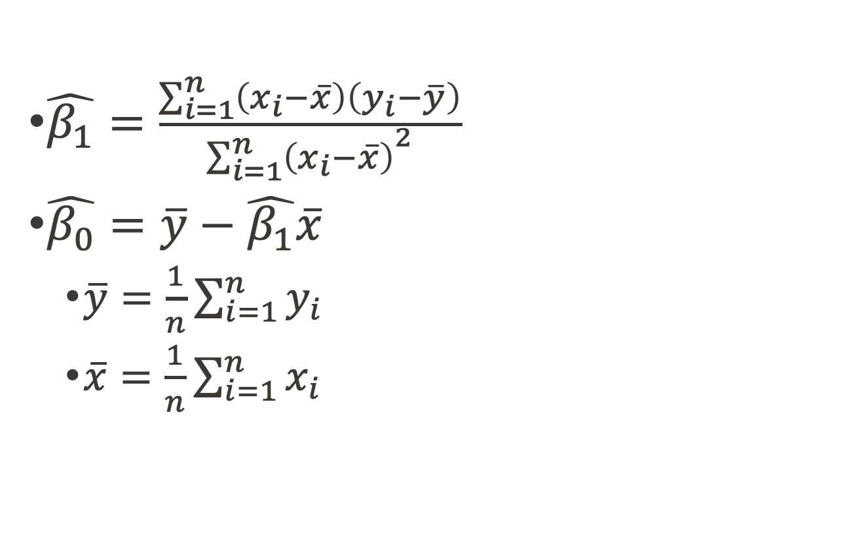
least squares : minimize the RSS
$\hat{β_{1}}=\frac{\sum_{i=1}^{n}{\left(x_{i}−\overline{x}\right)\left(y_{i}−\overline{y}\right)}}{{\sum_{i=1}^{n}{\left(x_{i}−\overline{x}\right)}}^{2}}$
$\hat{β_{0}}=\overline{y}−\hat{β_{1}}\overline{x}$
$\overline{y}=\frac{1}{n}\sum_{i=1}^{n}{y_{i}}$
$\overline{x}=\frac{1}{n}\sum_{i=1}^{n}{x_{i}}$
An Introduction to Statistical Learning with Applications in R by Gareth James, Daniela Witten, Trevor Hastie, Robert Tibshirani

Slide 44
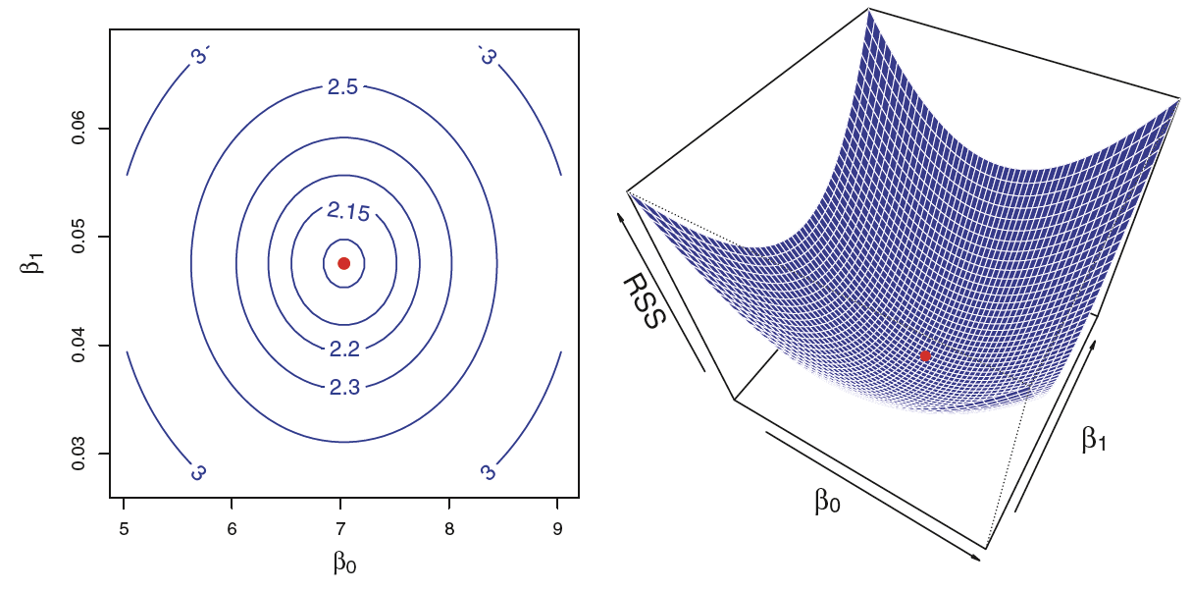
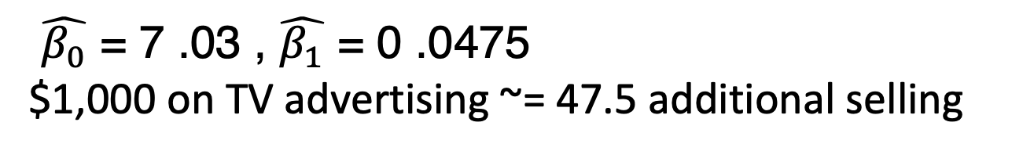
$\hat{β_{0}}$ = 7 .03 , $\hat{β_{1}}$ = 0 .0475
$1,000 on TV advertising ~= 47.5 additional selling
Figure 3.2, p63, An Introduction to Statistical Learning, with applications in R" (Springer, 2013) with permission from the authors: G. James, D. Witten, T. Hastie and R. Tibshirani

Slide 45
Prepare data
2011 US Census PUMS data
predict personal income from other demographic variables such as age and education
pums.R
load("psub.RData")
dtrain <- subset(psub,ORIGRANDGROUP >= 500)
dtest <- subset(psub,ORIGRANDGROUP < 500)
Practical Data Science with R by Nina Zumel, John Mount

Slide 46
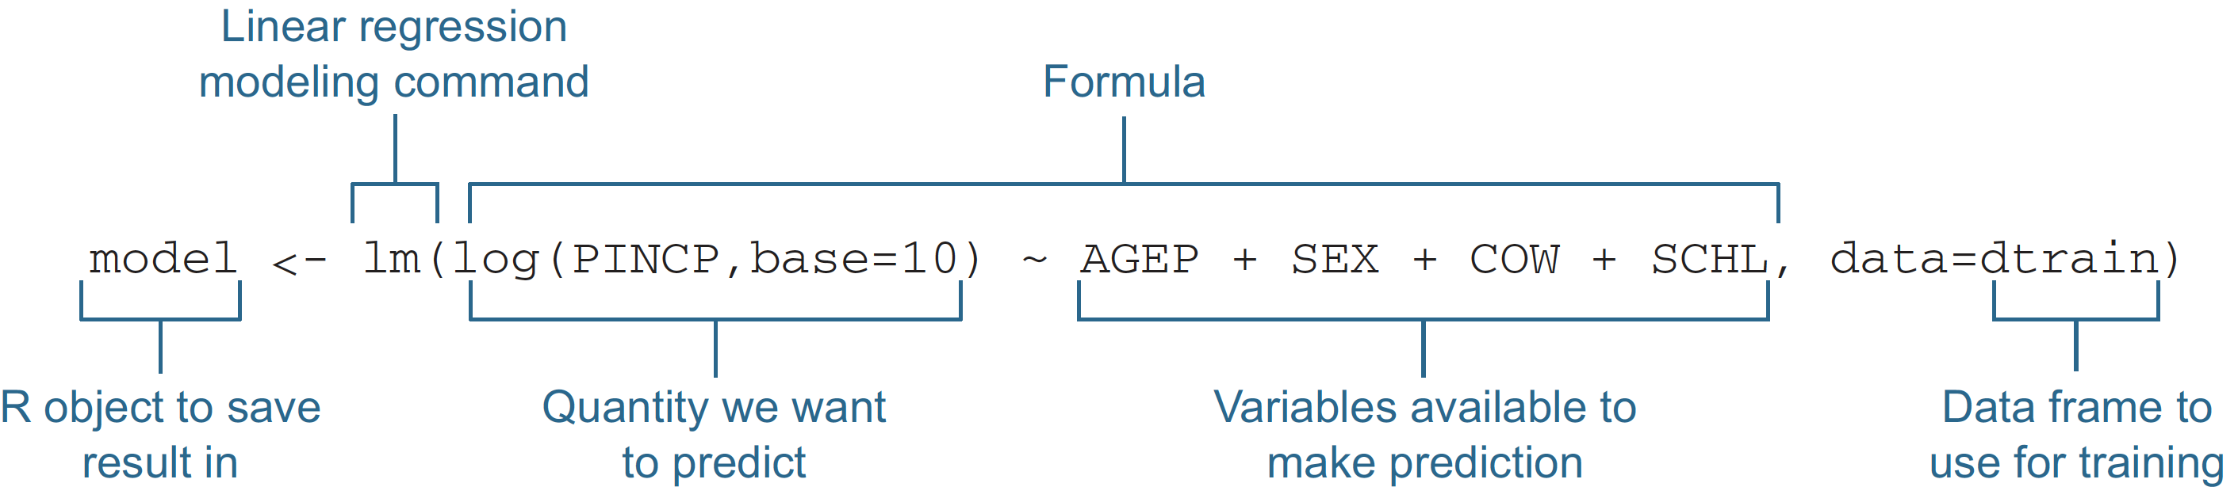
Building a linear model using the lm() command
Predict the log base 10 of income as a function of age, sex, employment class, and education.
Output
Personal income (PINCP)
Input
age (AGEP)
Sex (SEX) : reference level =M
class of worker (COW) : reference level = Employee of a private for-profit
level of education (SCHL) : reference level = no high school diploma
Figure7.2, p145, Practical Data Science with R by Nina Zumel, John Mount

Slide 47
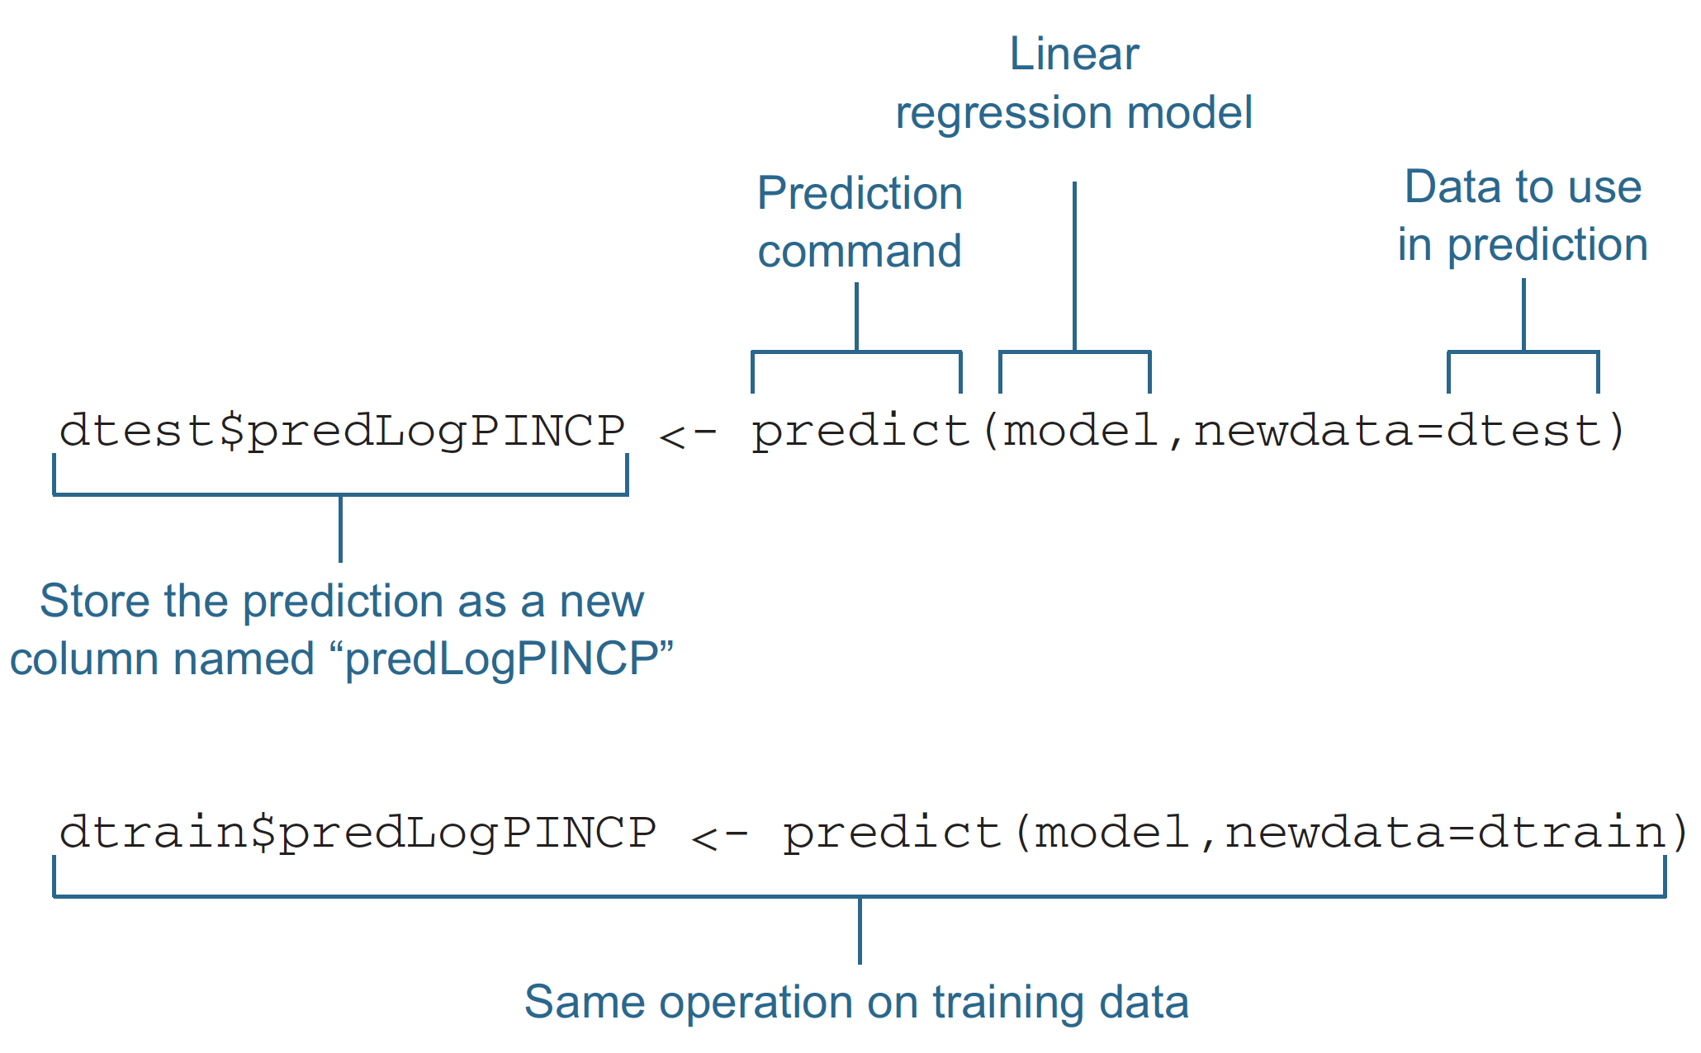
Making predictions with a linear regression model
Figure7.3, p145, Practical Data Science with R by Nina Zumel, John Mount

Slide 48
Check coefficients?
Linear regression

Slide 49
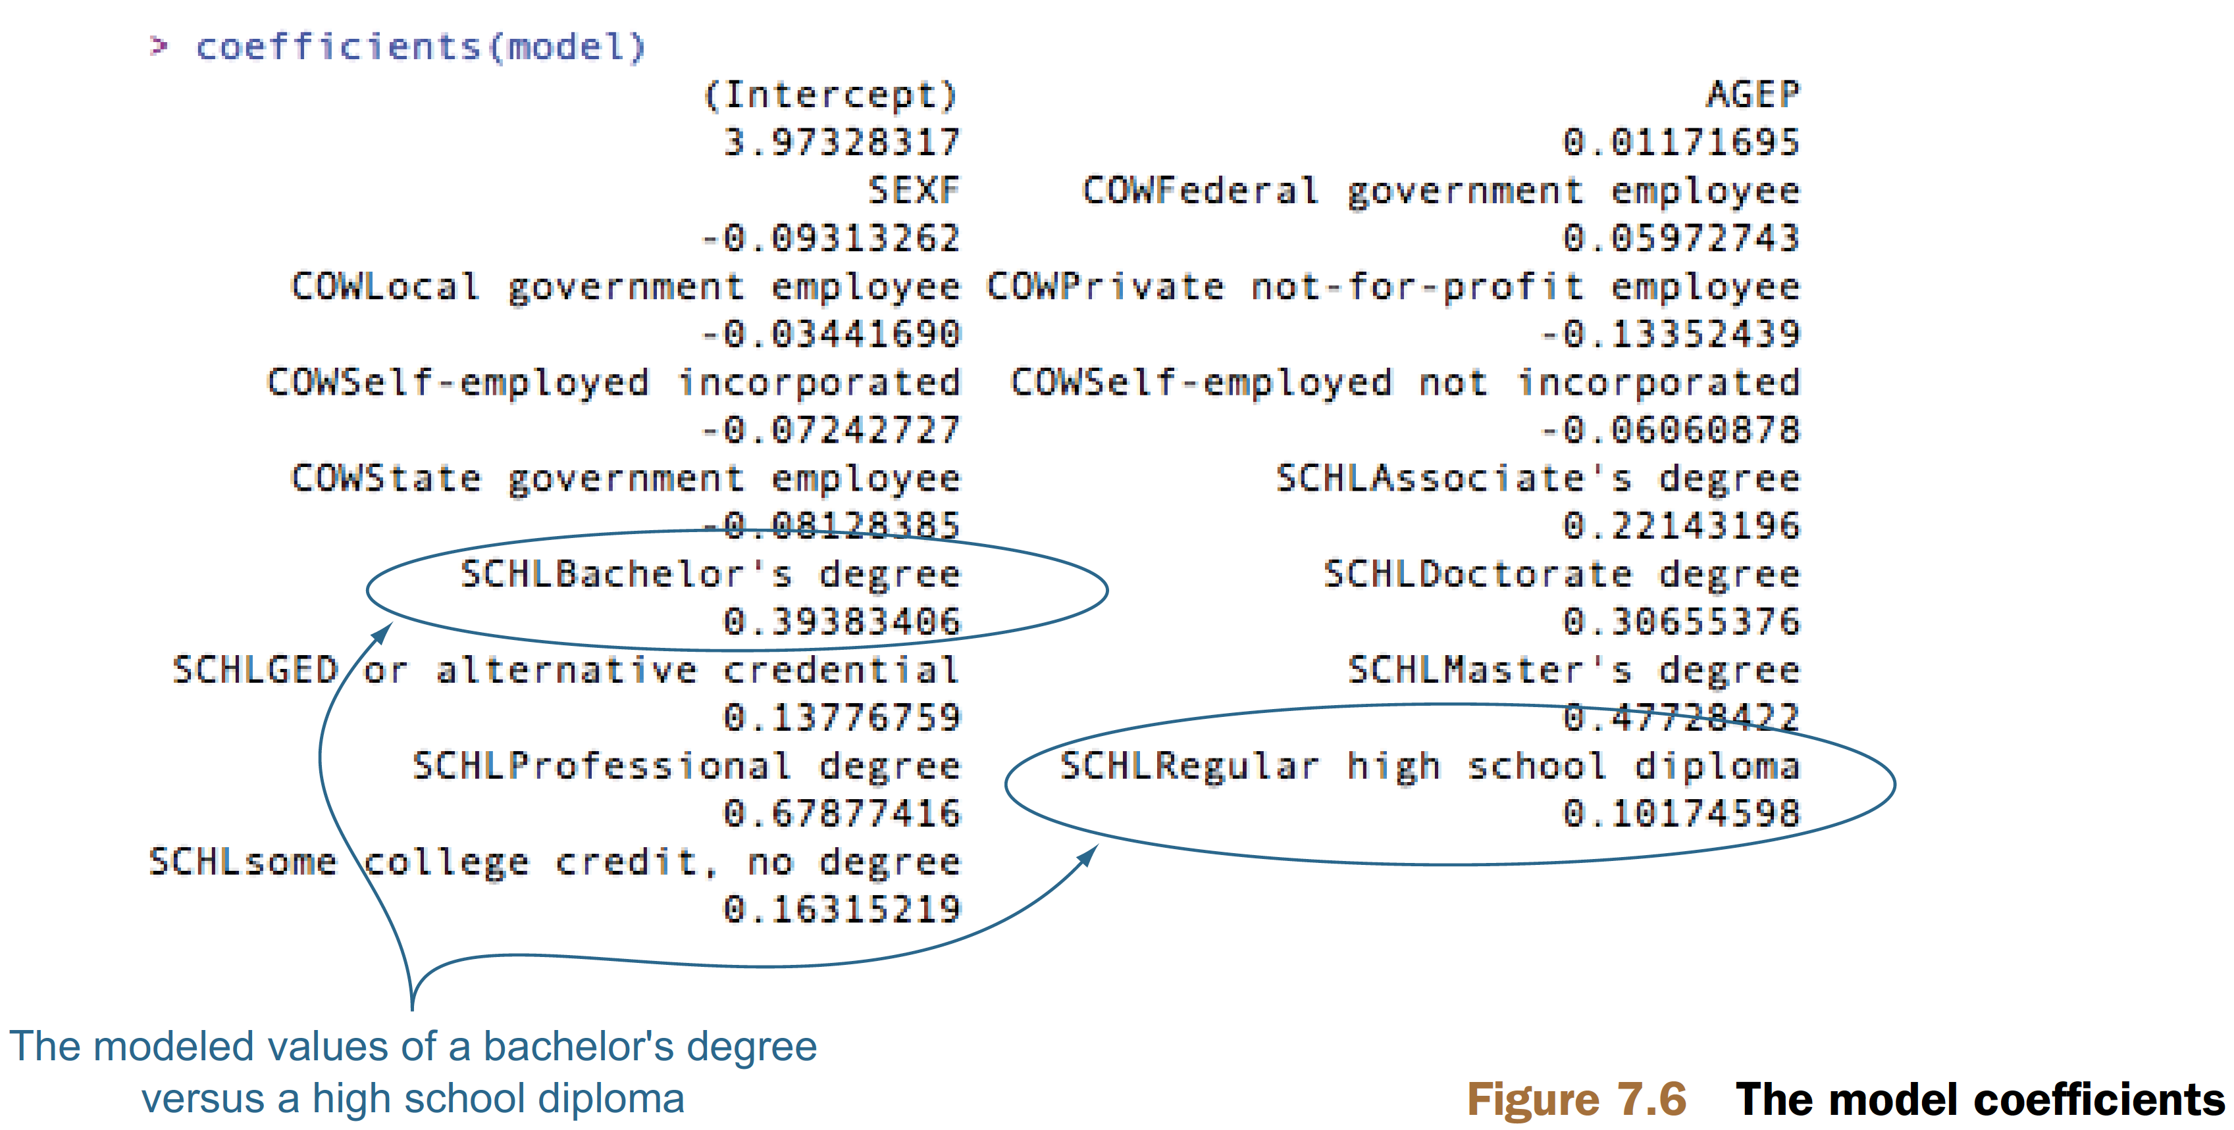
Finding relations and extracting advice
coefficients(model)
The level that isn’t shown is called the reference level
What is the reference level for SCHL?
levels(dtrain$SCHL)
Figure 7.6, p150, Practical Data Science with R by Nina Zumel, John Mount

Slide 50
Finding relations and extracting advice
The modeled relation between the bachelor’s degree holder’s expected income and high school graduate’s ?
Figure 7.6, p150, Practical Data Science with R by Nina Zumel, John Mount

Slide 51
SCHLBachelor's degree the coefficient = 0.39
The model gives a 0.39 bonus to log income for having a bachelor’s degree, relative to not having a high school degree.
Figure 7.6, p150, Practical Data Science with R by Nina Zumel, John Mount

Slide 52
Finding relations and extracting advice
AGEP is a continuous variable with coefficient 0.0117?
a one-year increase in age, adding a 0.0117 bonus to log income
Figure 7.6, p150, Practical Data Science with R by Nina Zumel, John Mount

Slide 53
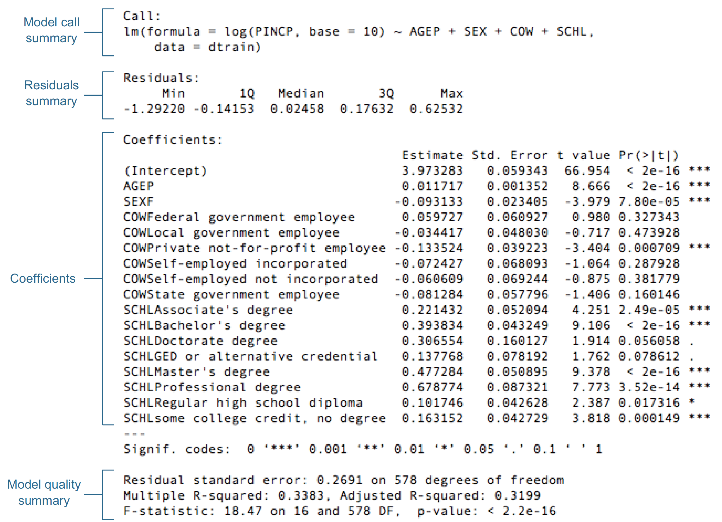
Reading the model summary and characterizing coefficient quality
summary(model)
Figure 7.7, p152, Practical Data Science with R by Nina Zumel, John Mount

Slide 54
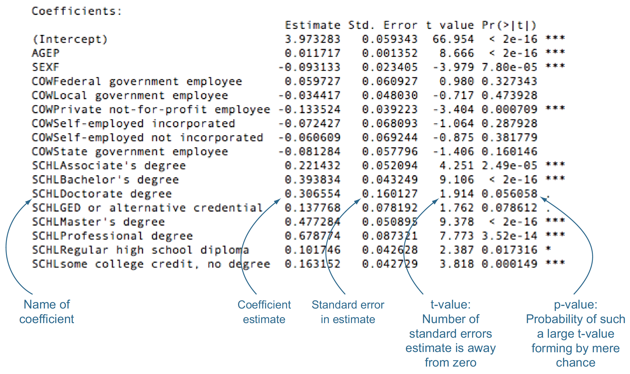
The Coefficients Table
summary(model)$coefficients
Figure 7.8, p153, Practical Data Science with R by Nina Zumel, John Mount

Slide 55
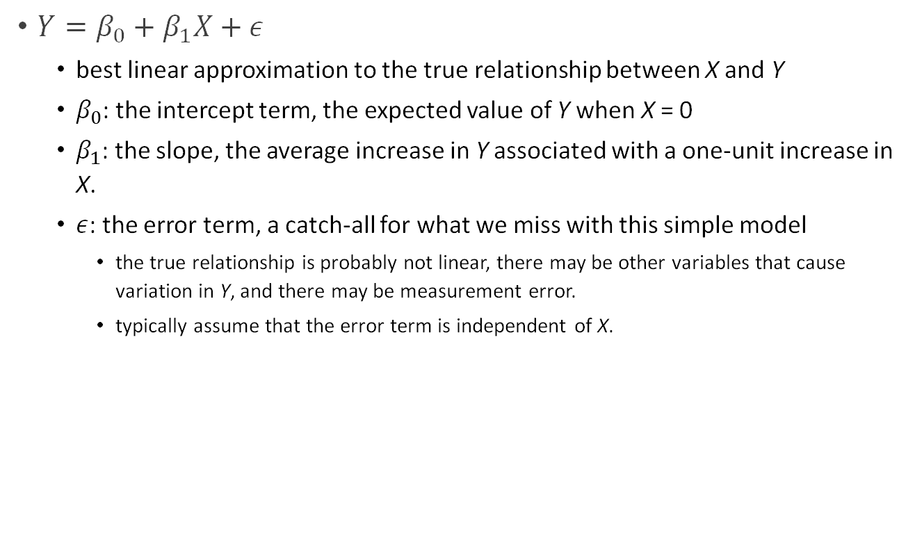
Population regression line
$Y=β_{0}+β_{1}X+ε$
best linear approximation to the true relationship between X and Y
$β_{0}$: the intercept term, the expected value of Y when X = 0
$β_{1}$: the slope, the average increase in Y associated with a one-unit increase in X.
$ε$: the error term, a catch-all for what we miss with this simple model
the true relationship is probably not linear, there may be other variables that cause variation in Y, and there may be measurement error.
typically assume that the error term is independent of X.
An Introduction to Statistical Learning with Applications in R by Gareth James, Daniela Witten, Trevor Hastie, Robert Tibshirani

Slide 56
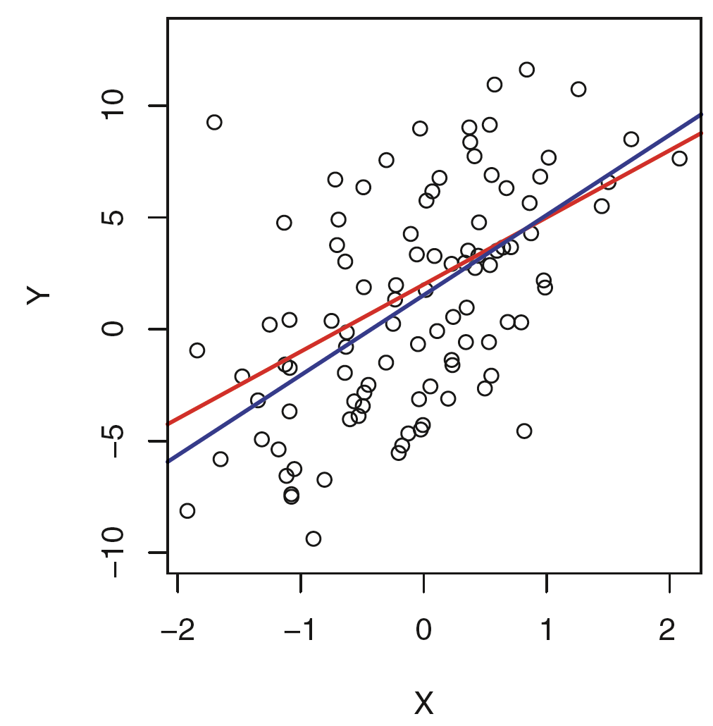
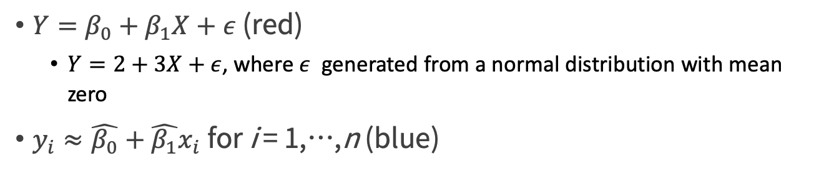
The population regression line vs least squares estimate
$Y=β_{0}+β_{1}X+ε$ (red)
$Y=2+3X+ε$, where $ε$ generated from a normal distribution with mean zero
$y_{i}≈\hat{β_{0}}+\hat{β_{1}}x_{i}$for i = 1,…,n (blue)
Figure3.3, p64, An Introduction to Statistical Learning, with applications in R" (Springer, 2013) with permission from the authors: G. James, D. Witten, T. Hastie and R. Tibshirani

Slide 57
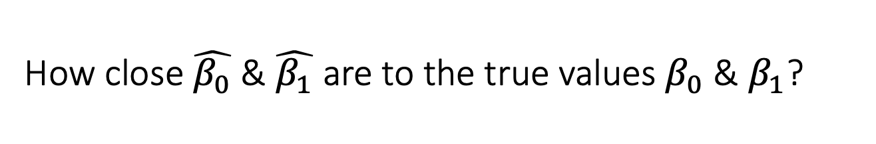
How close $\hat{β_{0}}$& $\hat{β_{1}}$ are to the true values $β_{0}$ & $β_{1}$?
we are interested in knowing the population mean μ of some random variable Y
Unfortunately, μ is unknown, but we do have access to n observations from Y, y₁,…,y_{n}
An Introduction to Statistical Learning with Applications in R by Gareth James, Daniela Witten, Trevor Hastie, Robert Tibshirani

Slide 58
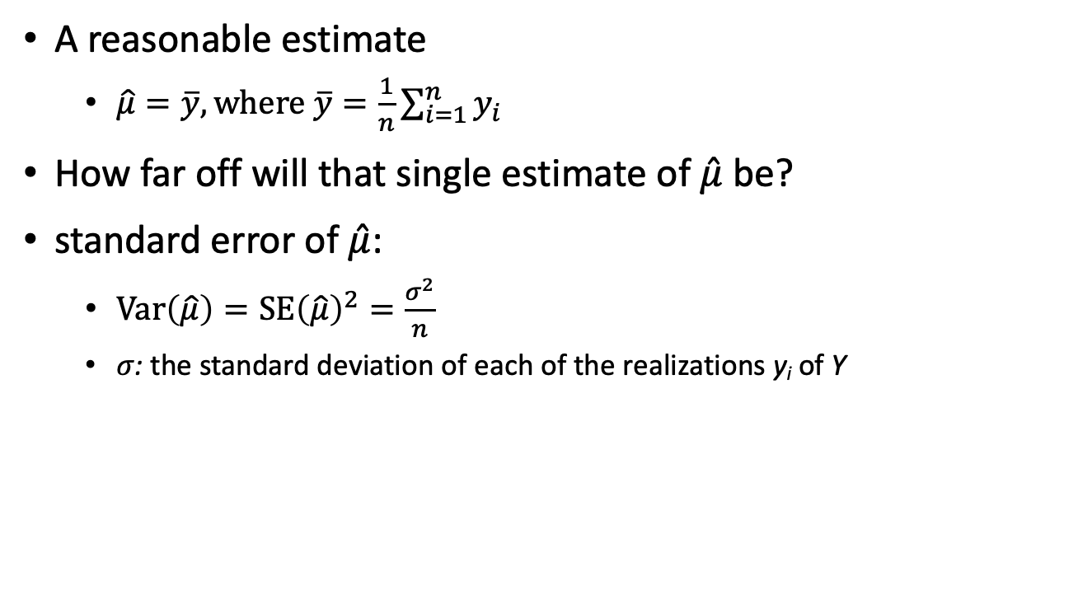
How close $\hat{β_{0}}$& $\hat{β_{1}}$ are to the true values $β_{0}$ & $β_{1}$?
A reasonable estimate
$\hat{μ}=\overline{y}, \text{where} \overline{y}=\frac{1}{n}\sum_{i=1}^{n}{y_{i}}$
How far off will that single estimate of $\hat{μ}$ be?
standard error of $\hat{μ}$:
$Var\left(\hat{μ}\right)=\text{SE}{\left(\hat{μ}\right)}^{2}=\frac{σ^{2}}{n}$
$σ$: the standard deviation of each of the realizations y_{i} of Y
An Introduction to Statistical Learning with Applications in R by Gareth James, Daniela Witten, Trevor Hastie, Robert Tibshirani

Slide 59
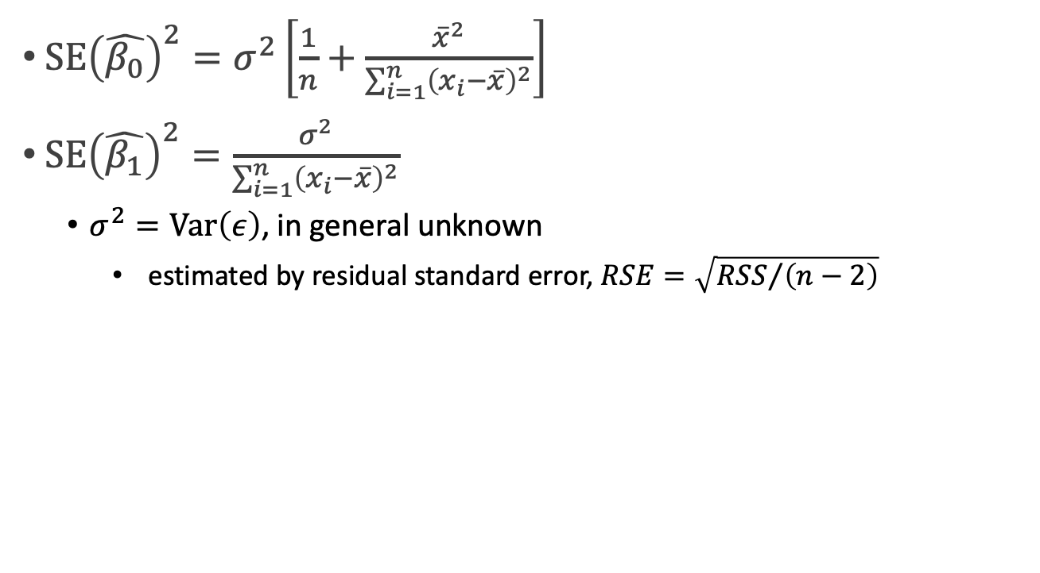

The standard errors of $\hat{β_{0}}$& $\hat{β_{1}}$
$\text{SE}{\left(\hat{β_{0}}\right)}^{2}=σ^{2}\left[\frac{1}{n}+\frac{{\overline{x}}^{2}}{\sum_{i=1}^{n}{{\left(x_{i}−\overline{x}\right)}^{2}}}\right]$
$\text{SE}{\left(\hat{β_{1}}\right)}^{2}=\frac{σ^{2}}{\sum_{i=1}^{n}{{\left(x_{i}−\overline{x}\right)}^{2}}}$
$σ^{2}=Var\left(ε\right)$, in general unknown
estimated by residual standard error, $RSE=\sqrt{{RSS}/{\left(n−2\right)}}$

Slide 60
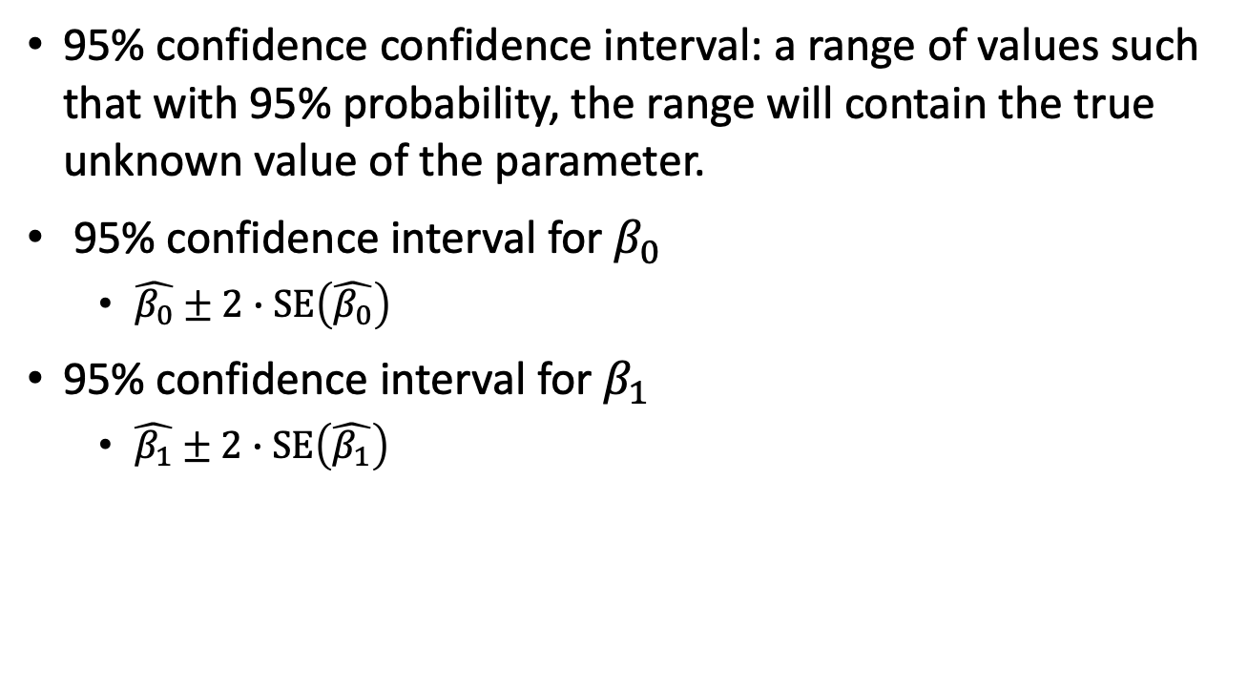
Confidence intervals
95% confidence confidence interval: a range of values such that with 95% probability, the range will contain the true unknown value of the parameter.
95% confidence interval for $β_{0}$
$\hat{β_{0}}±2∙\text{SE}\left(\hat{β_{0}}\right)$
95% confidence interval for $β_{1}$
$\hat{β_{1}}±2∙\text{SE}\left(\hat{β_{1}}\right)$
An Introduction to Statistical Learning with Applications in R by Gareth James, Daniela Witten, Trevor Hastie, Robert Tibshirani

Slide 61
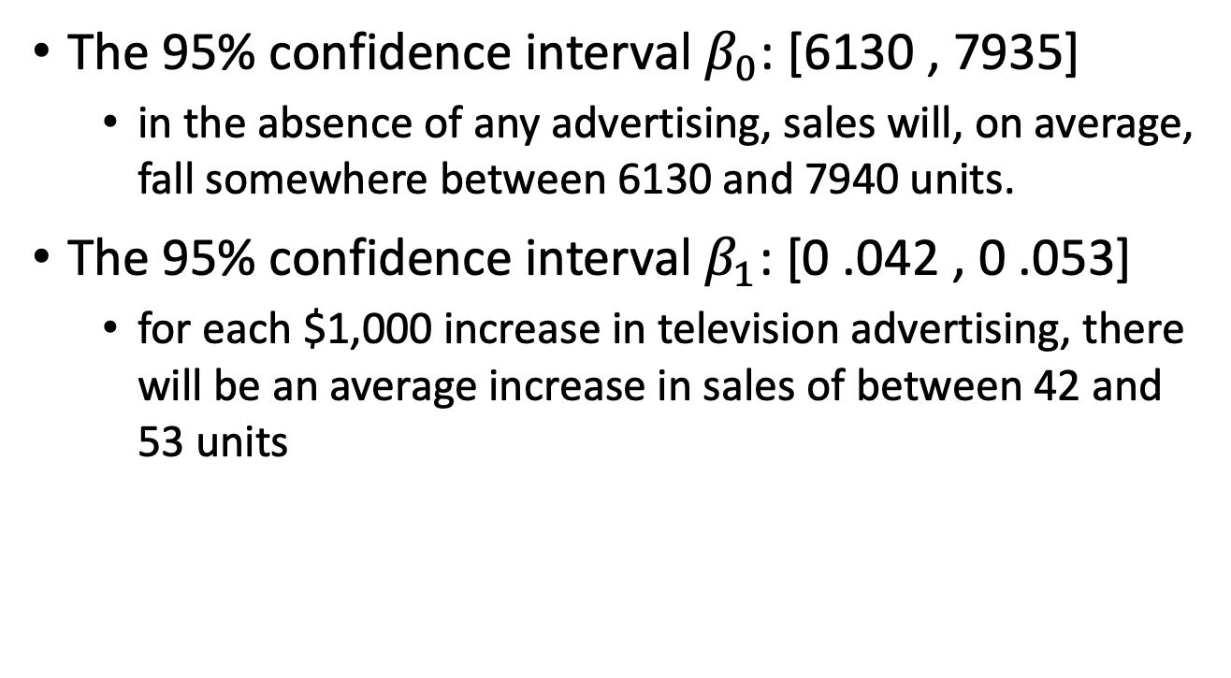
TV @ Sales example
The 95% confidence interval $β_{0}$: [6130 , 7935]
in the absence of any advertising, sales will, on average, fall somewhere between 6130 and 7940 units.
The 95% confidence interval $β_{1}$: [0 .042 , 0 .053]
for each $1,000 increase in television advertising, there will be an average increase in sales of between 42 and 53 units
An Introduction to Statistical Learning with Applications in R by Gareth James, Daniela Witten, Trevor Hastie, Robert Tibshirani

Slide 62
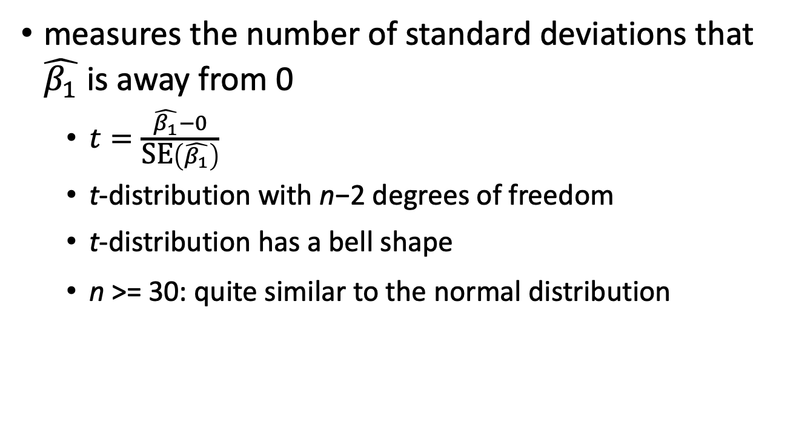
t-statistic
measures the number of standard deviations that $\hat{β_{1}}$ is away from 0
$t=\frac{\hat{β_{1}}−0}{\text{SE}\left(\hat{β_{1}}\right)}$
t-distribution with n−2 degrees of freedom
t-distribution has a bell shape
n >= 30: quite similar to the normal distribution
An Introduction to Statistical Learning with Applications in R by Gareth James, Daniela Witten, Trevor Hastie, Robert Tibshirani

Slide 63
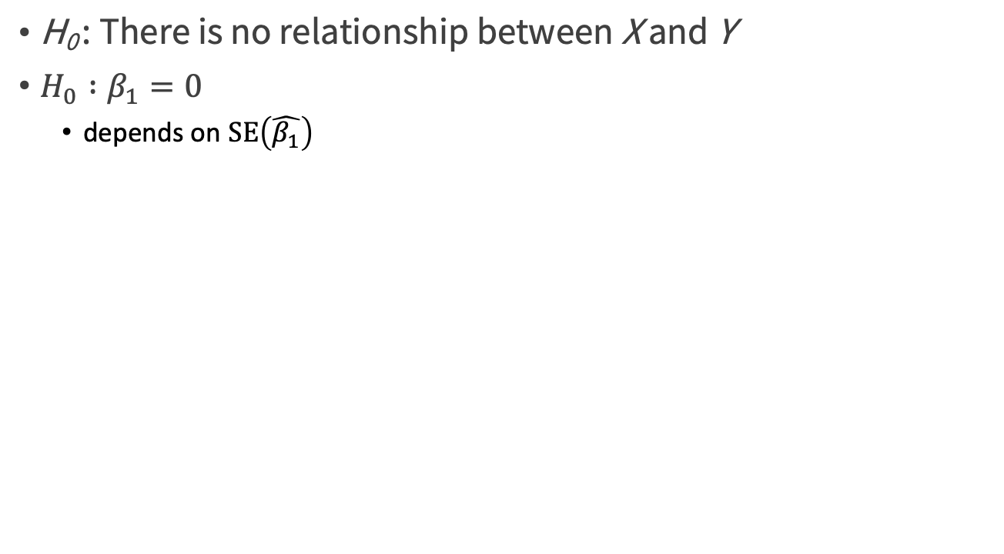
Null hypothesis
H₀ : There is no relationship between X and Y
${H_{0} :β}_{1}=0$
depends on $\text{SE}\left(\hat{β_{1}}\right)$
An Introduction to Statistical Learning with Applications in R by Gareth James, Daniela Witten, Trevor Hastie, Robert Tibshirani

Slide 64
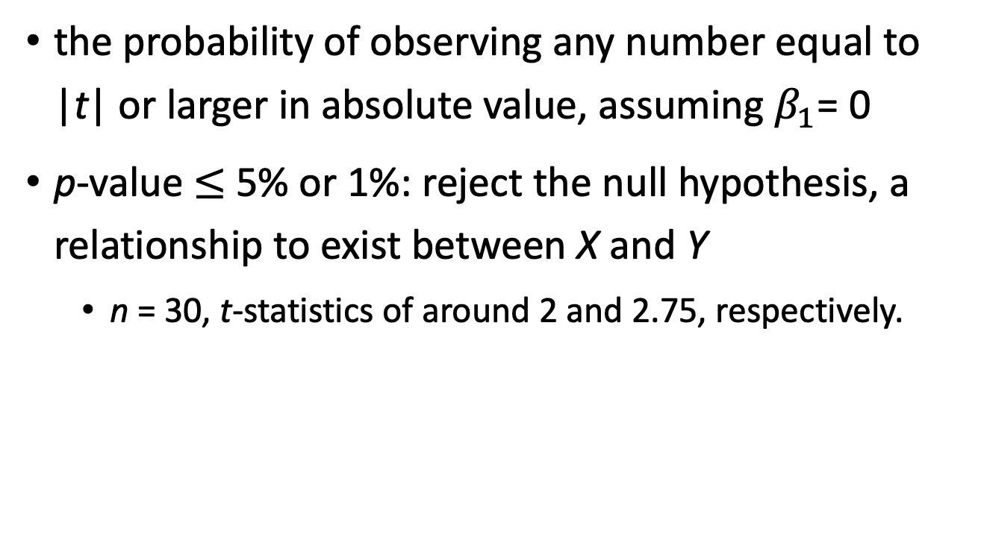
p-value
the probability of observing any number equal to |t| or larger in absolute value, assuming $β_{1}$= 0
p-value $≤$ 5% or 1%: reject the null hypothesis, a relationship to exist between X and Y
n = 30, t-statistics of around 2 and 2.75, respectively.
An Introduction to Statistical Learning with Applications in R by Gareth James, Daniela Witten, Trevor Hastie, Robert Tibshirani

Slide 65
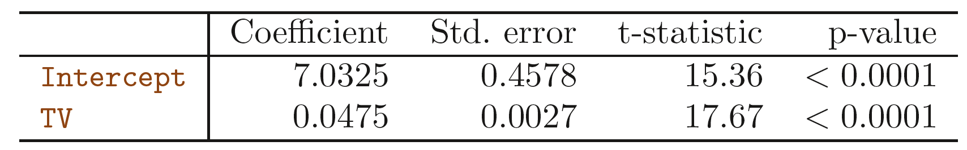
TV @ Sales example
An Introduction to Statistical Learning with Applications in R by Gareth James, Daniela Witten, Trevor Hastie, Robert Tibshirani

Slide 66
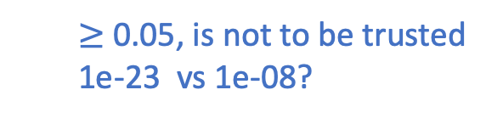
p-value
the probability of seeing a coefficient with a magnitude as large as we observe if the true coefficient is really 0 (the variable has no effect on the outcome)
$≥$ 0.05, is not to be trusted
1e-23 vs 1e-08?
Figure7.8, Practical Data Science with R by Nina Zumel, John Mount

Slide 67
Multiple Linear Regression vs. Separate simple linear regression

Slide 68
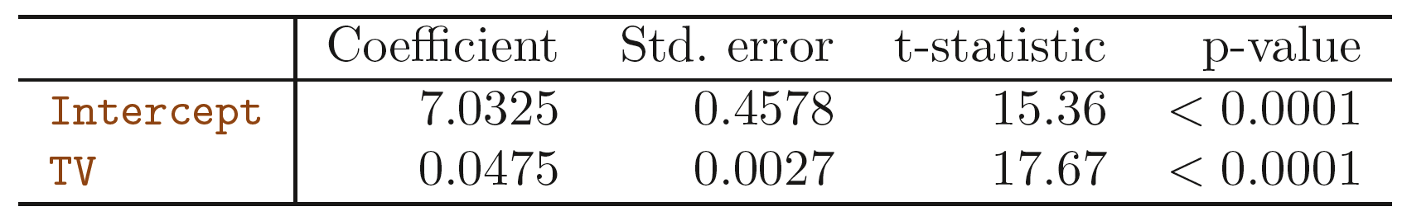
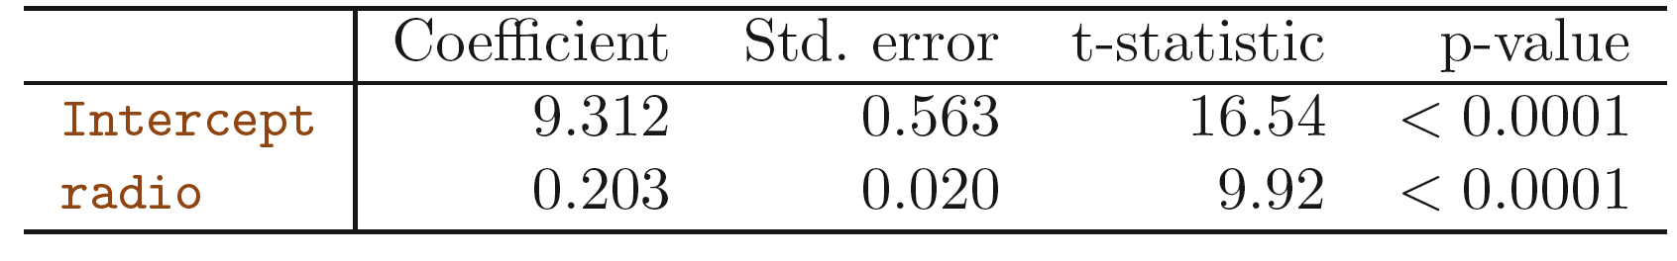
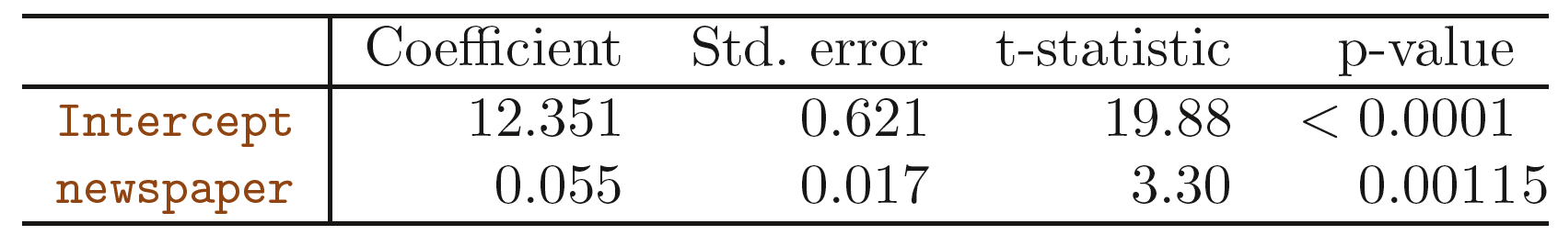
Separate simple linear regression
An Introduction to Statistical Learning with Applications in R by Gareth James, Daniela Witten, Trevor Hastie, Robert Tibshirani

Slide 69
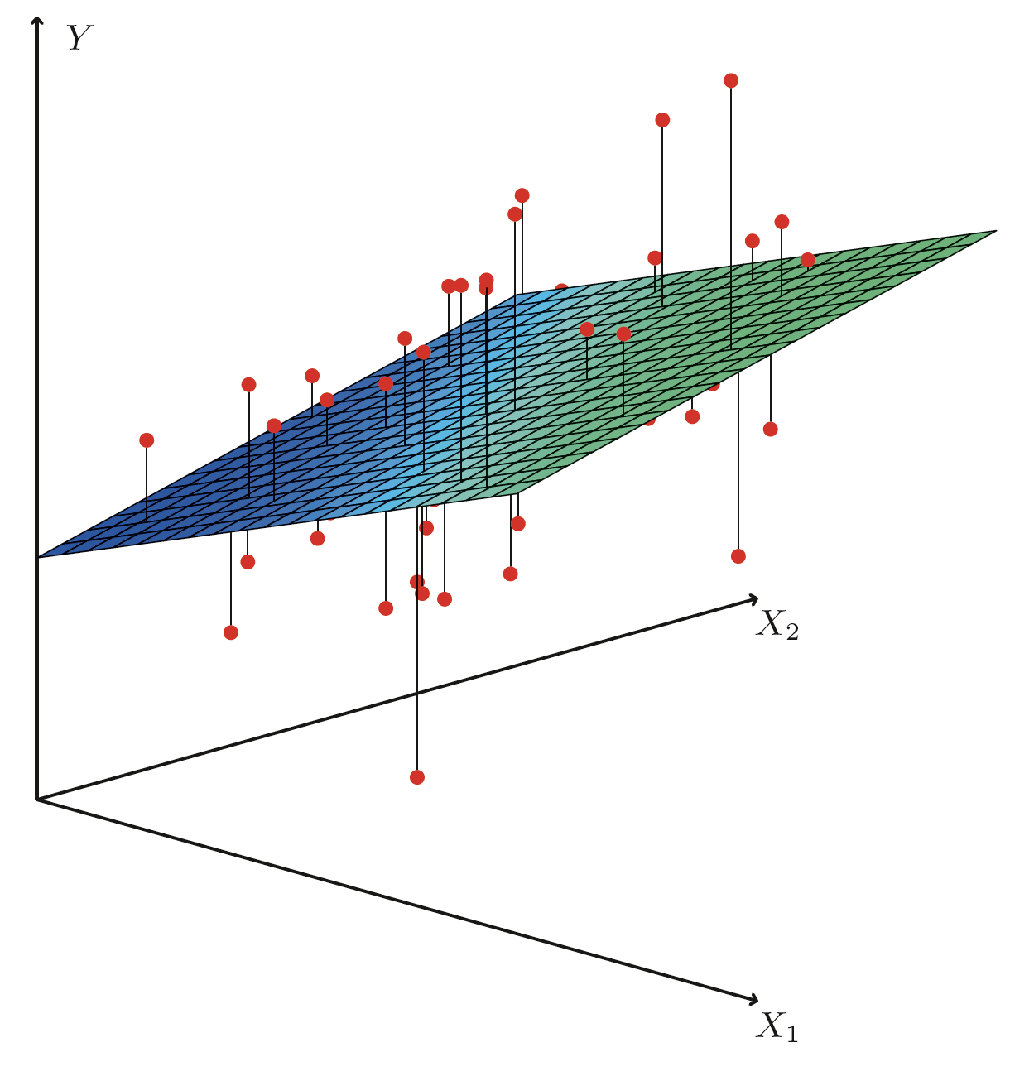
Multiple Linear Regression
sales = β₀ + β₁x TV + β₂ x radio + β₃ x newspaper + $ε$
Figure3.4, p64, An Introduction to Statistical Learning, with applications in R" (Springer, 2013) with permission from the authors: G. James, D. Witten, T. Hastie and R. Tibshirani

Slide 70
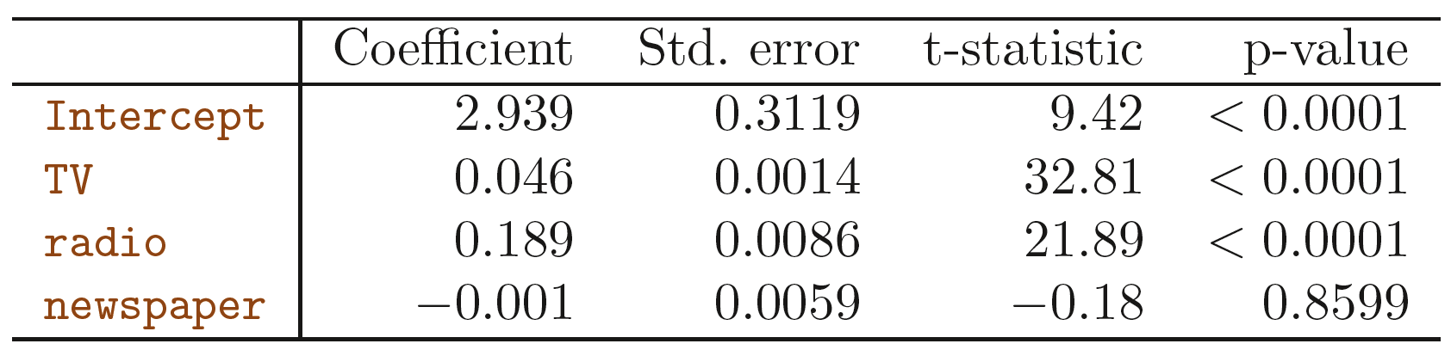
Multiple Linear Regression
An Introduction to Statistical Learning with Applications in R by Gareth James, Daniela Witten, Trevor Hastie, Robert Tibshirani

Slide 71
Multiple Linear Regression vs. Separate simple linear regression
An Introduction to Statistical Learning with Applications in R by Gareth James, Daniela Witten, Trevor Hastie, Robert Tibshirani

Slide 72
Multiple Linear Regression vs. Separate simple linear regression
the coefficient for newspaper represents the average effect of increasing newspaper spending by $1000 while holding TV and radio fixed.
The slope term represents the average effect of a $1000 increase in newspaper advertising, ignoring other predictors such as TV and radio
An Introduction to Statistical Learning with Applications in R by Gareth James, Daniela Witten, Trevor Hastie, Robert Tibshirani

Slide 73
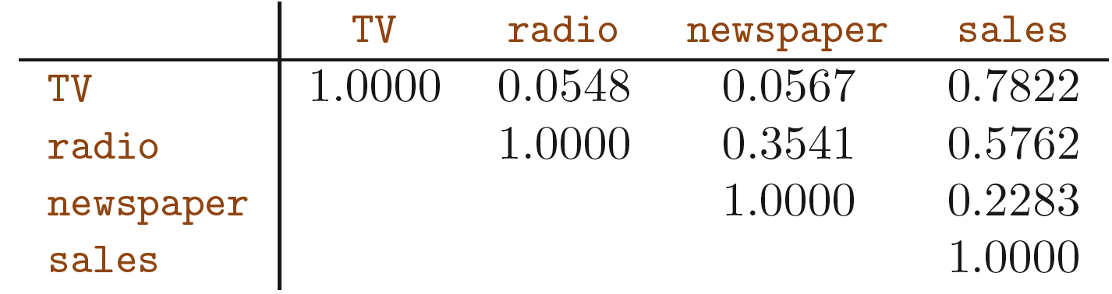
Correlation matrix
higher values of newspaper tend to be associated with higher values of sales , even though newspaper advertising does not actually affect sales
newspaper gets “credit” for the effect of radio on sales.
An Introduction to Statistical Learning with Applications in R by Gareth James, Daniela Witten, Trevor Hastie, Robert Tibshirani

Slide 74
shark attacks vs. ice cream sales
a regression of shark attacks vs. ice cream sales for data collected at a given beach community over a period of time => a positive relationship
Higher temperatures cause more people to visit the beach, which in turn results in more ice cream sales and more shark attacks.
multiple regression
attacks vs. ice cream sales + temperature
ice cream sales is no longer significant after adjusting for temperature.
An Introduction to Statistical Learning with Applications in R by Gareth James, Daniela Witten, Trevor Hastie, Robert Tibshirani

Slide 75
How to evaluate scoring models?
Linear regression

Slide 76
Predict based on trained model
dtest$predLogPINCP <- predict(model,newdata=dtest)
dtrain$predLogPINCP <- predict(model,newdata=dtrain)
Practical Data Science with R by Nina Zumel, John Mount

Slide 77
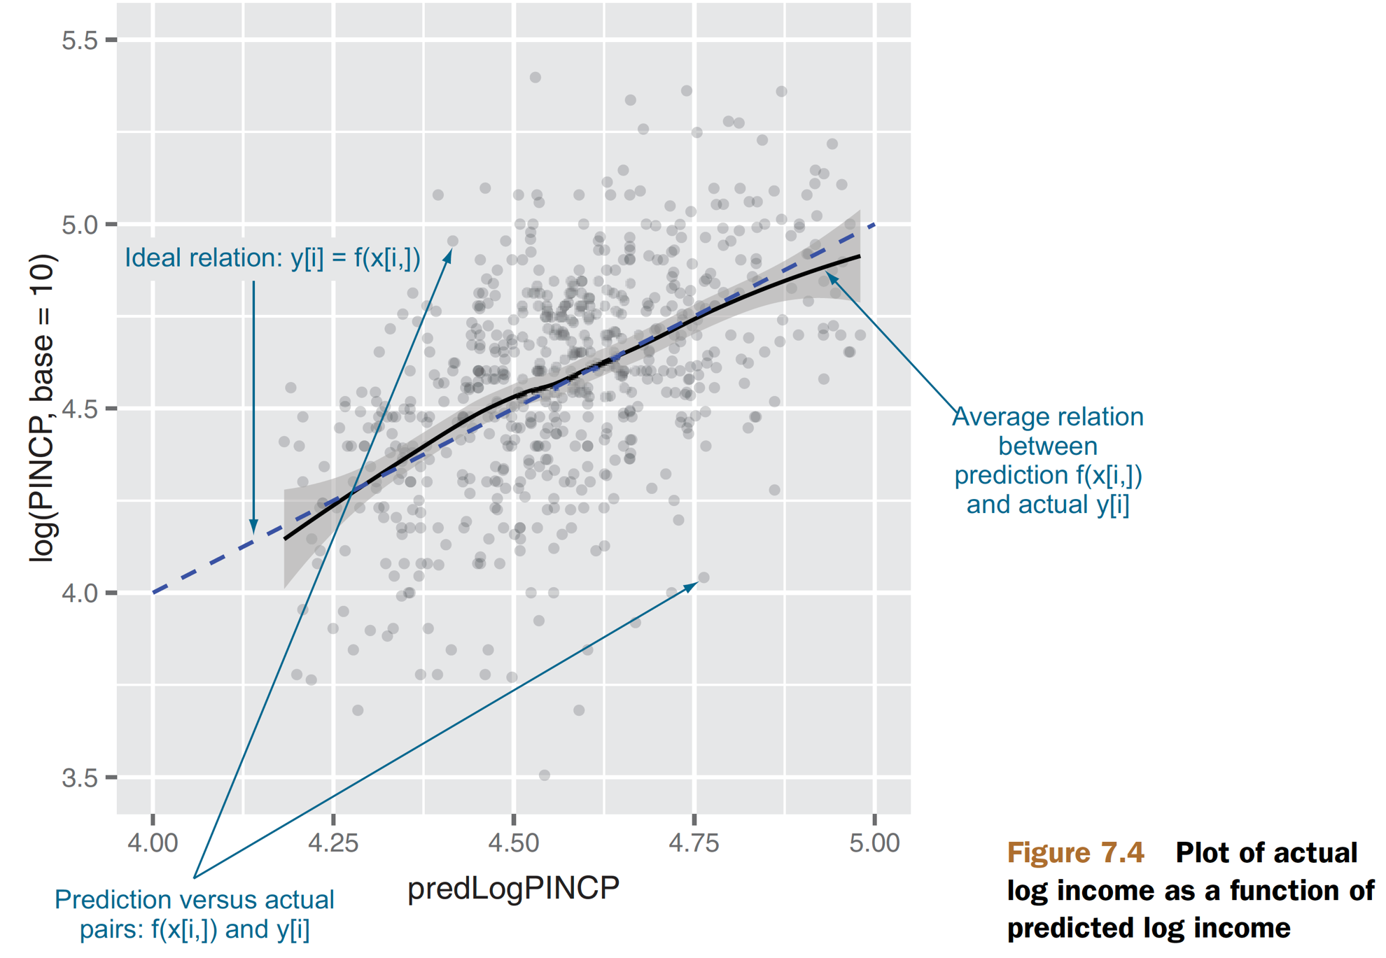
Characterizing prediction quality
ggplot(data=dtest,aes(x=predLogPINCP,y=log(PINCP,base=10))) +
geom_point(alpha=0.2,color="black") +
geom_smooth(aes(x=predLogPINCP, y=log(PINCP,base=10)),color="black") +
geom_line(aes(x=log(PINCP,base=10), y=log(PINCP,base=10)),color="blue",linetype=2) +
scale_x_continuous(limits=c(4,5)) + scale_y_continuous(limits=c(3.5,5.5))
Figure7.4, Practical Data Science with R by Nina Zumel, John Mount

Slide 78
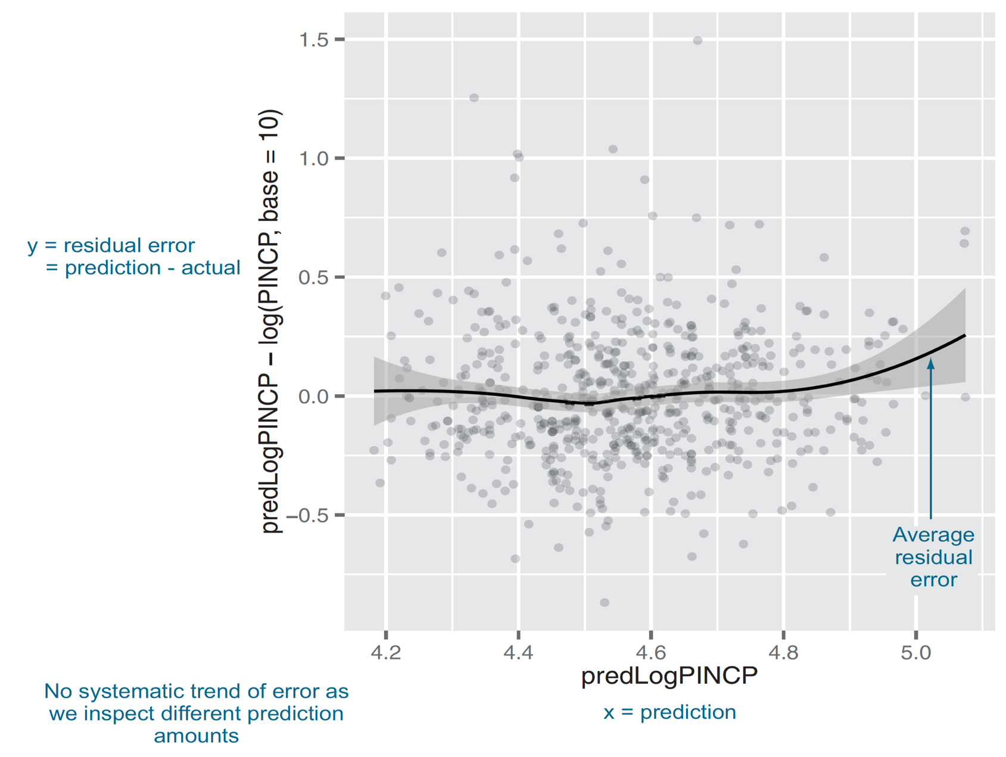
On average, are the predictions correct?
ggplot(data=dtest,aes(x=predLogPINCP,
y=predLogPINCP-log(PINCP,base=10))) +
geom_point(alpha=0.2,color="black") +
geom_smooth(aes(x=predLogPINCP, y=predLogPINCP-log(PINCP,base=10)), color="black")
Figure7.5, Practical Data Science with R by Nina Zumel, John Mount

Slide 79
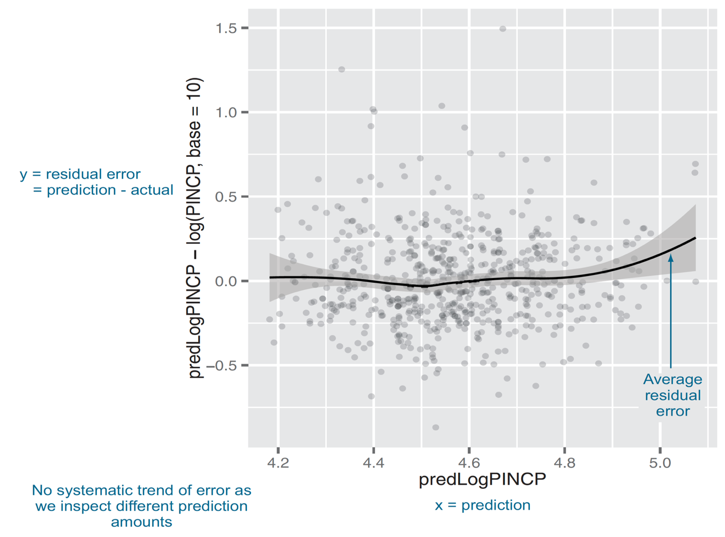
On average, are the predictions correct?
summary(log(dtrain$PINCP,base=10) - predict(model,newdata=dtrain))
summary(log(dtest$PINCP,base=10) - predict(model,newdata=dtest))
the median near 0
exactly half of the training data has a residual in 1st. Qu. and 3rd Qu. quantiles
Figure7.5, Practical Data Science with R by Nina Zumel, John Mount

Slide 80
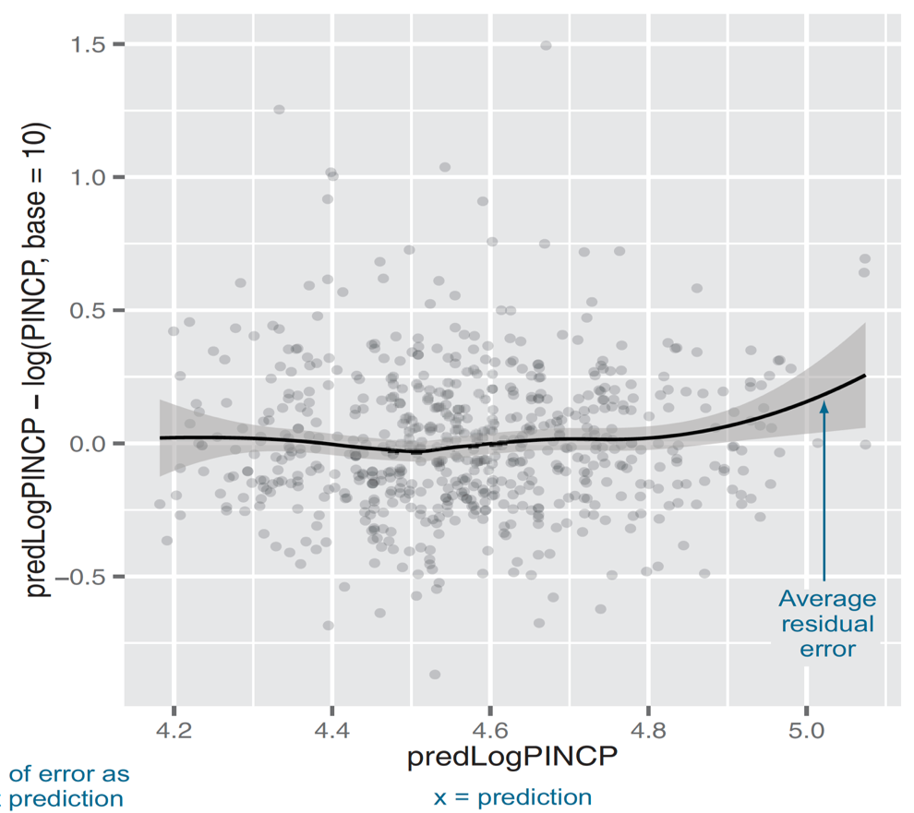
Why are the predictions, not the true values, on the x-axis?
A residual graph with
predictions on the x-axis
gives you a sense of when the model may be under- or overpredicting, based on the model’s output.
the true outcome on the x-axis
gives you a sense of where the model under or overpredicts based on the actual outcome.
Figure7.5, Practical Data Science with R by Nina Zumel, John Mount

Slide 81
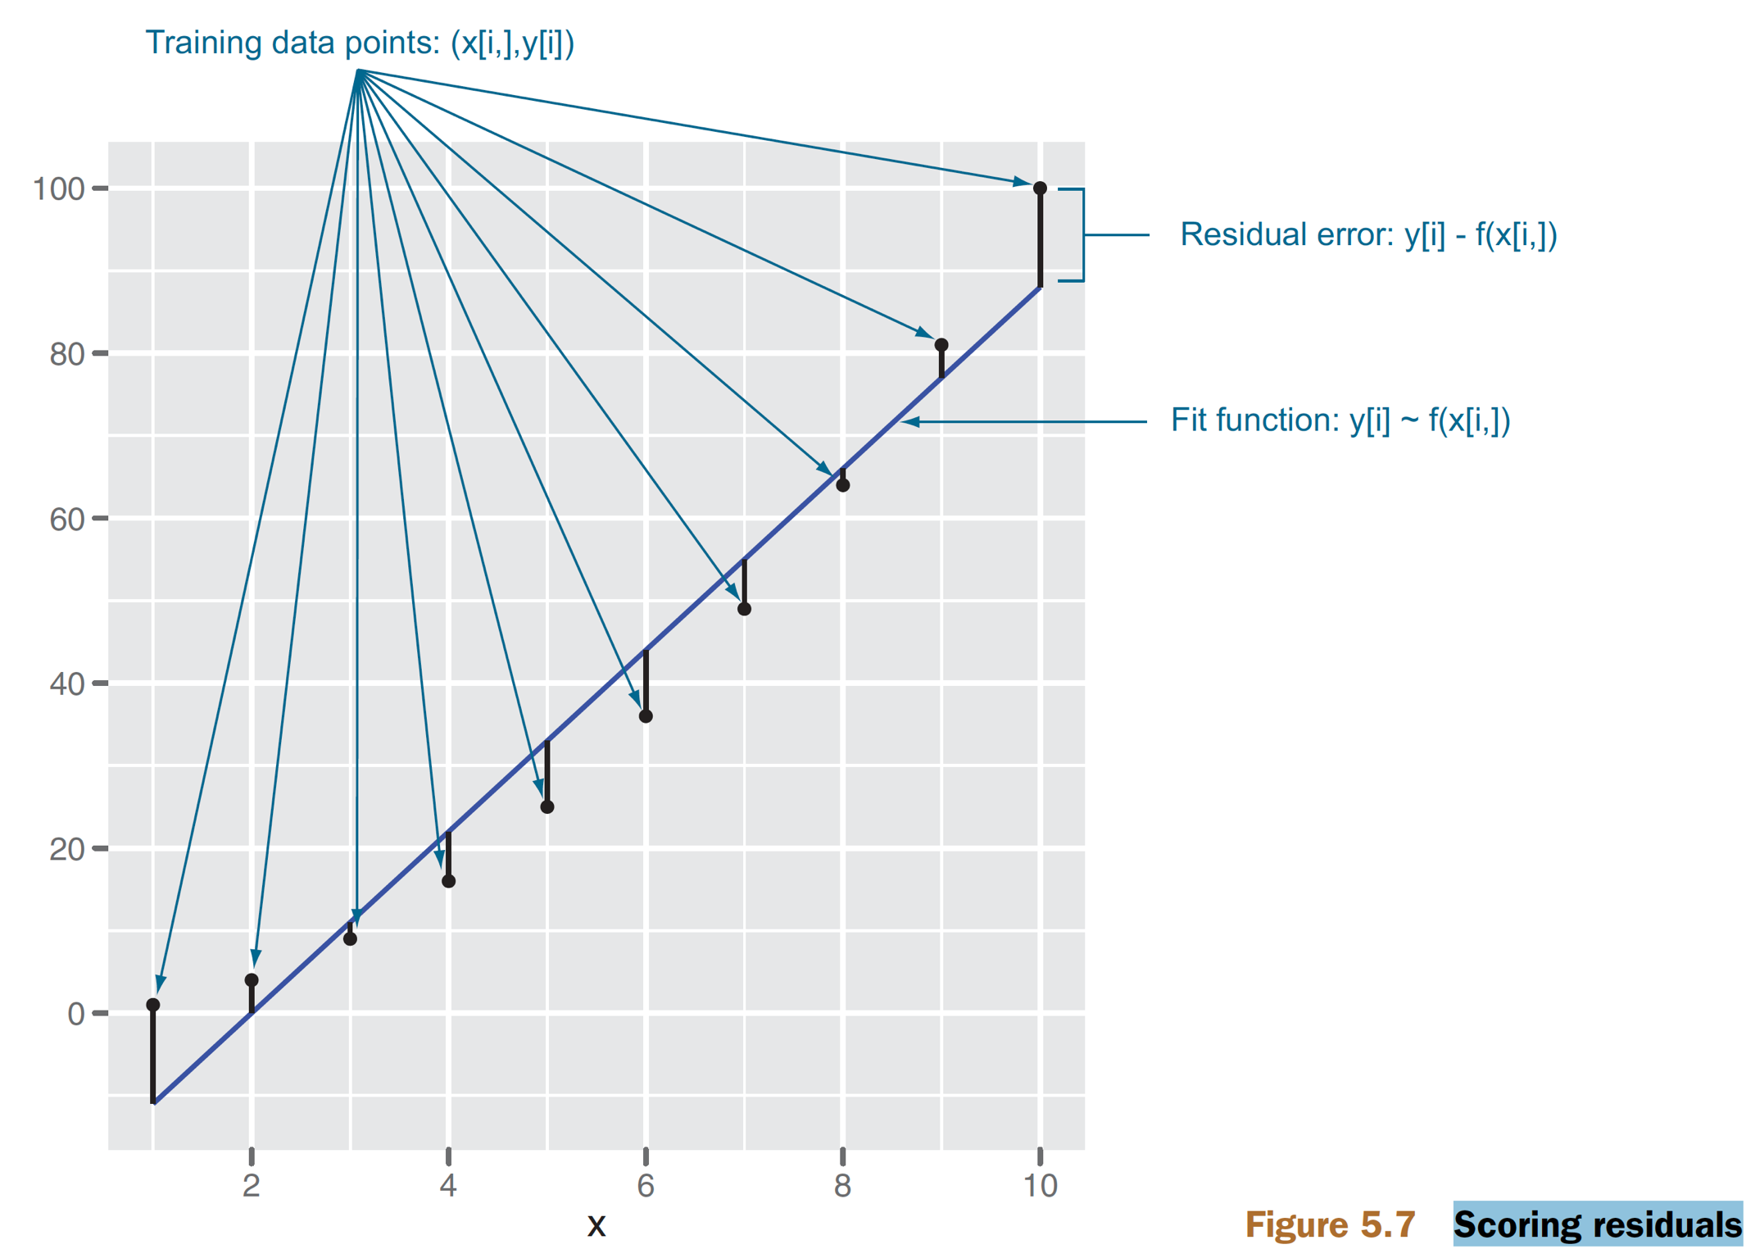
Scoring residuals
residuals or difference between our predictions and actual outcomes
Figure5.7, Practical Data Science with R by Nina Zumel, John Mount

Slide 82
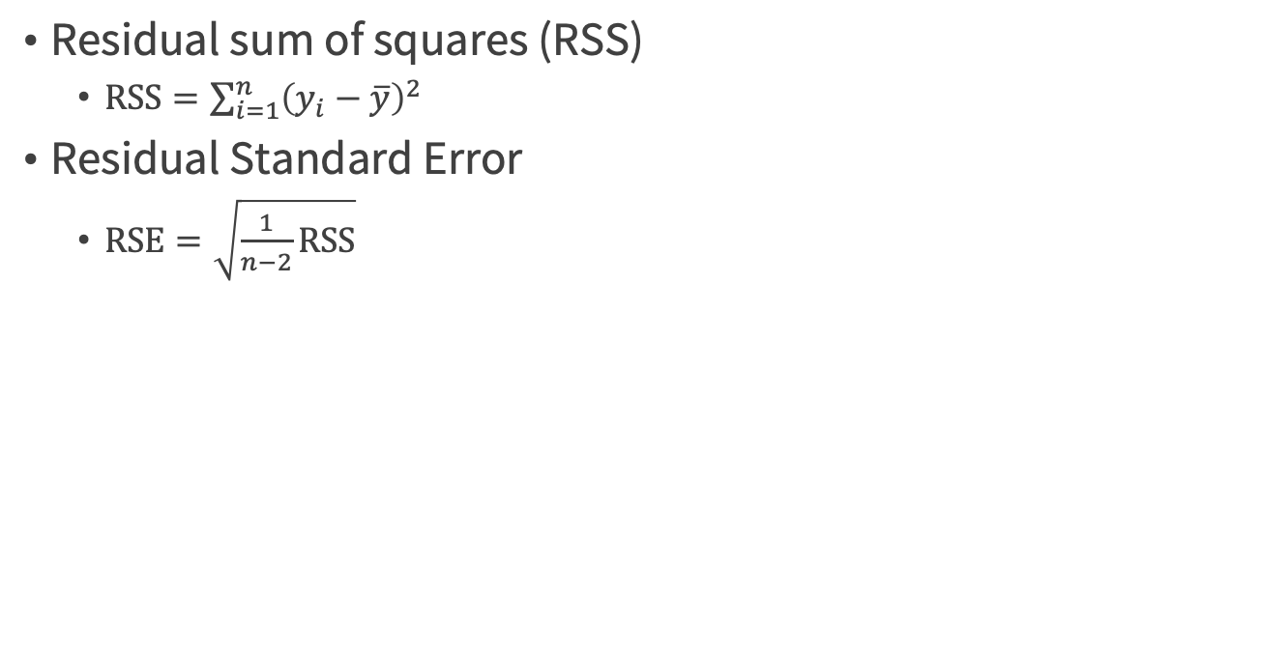
Residual Standard Error (RSE)
Residual sum of squares (RSS)
$\text{RSS}=\sum_{i=1}^{n}{{\left(y_{i}−\overline{y}\right)}^{2}}$
Residual Standard Error
$\text{RSE}=\sqrt{\frac{1}{n−2}\text{RSS}}$

Slide 83
Residual Standard Error (RSE)
TV @ Sales example
RSE = 3. 26
actual sales in each market deviate from the true regression line by approximately 3260 units, on average
if the model were correct and the true values of the unknown coefficients β₀ and β₁ were known exactly, any prediction of sales on the basis of TV advertising would still be off by about 3260 units on average.
An Introduction to Statistical Learning with Applications in R by Gareth James, Daniela Witten, Trevor Hastie, Robert Tibshirani

Slide 84
R-SQUARED (R²) statistic
The RSE provides an absolute measure of lack of fit of the model to the data.
measured in the units of Y => not always clear what constitutes a good RSE
R ² statistic: the form of a proportion, the proportion of variance explained, 0~1
independent of the scale of Y
An Introduction to Statistical Learning with Applications in R by Gareth James, Daniela Witten, Trevor Hastie, Robert Tibshirani

Slide 85
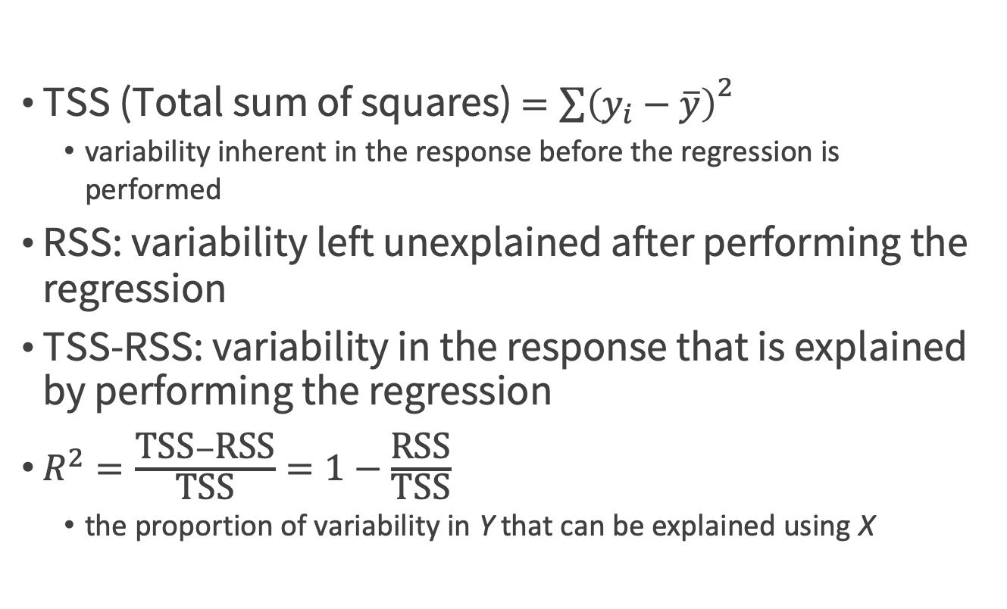
R² statistic
TSS (Total sum of squares) $={\sum{\left(y_{i}−\overline{y}\right)}}^{2}$
variability inherent in the response before the regression is performed
RSS: variability left unexplained after performing the regression
TSS-RSS: variability in the response that is explained by performing the regression
$R^{2}=\frac{\text{TSS}−\text{RSS}}{\text{TSS}}=1−\frac{\text{RSS}}{\text{TSS}}$
the proportion of variability in Y that can be explained using X
An Introduction to Statistical Learning with Applications in R by Gareth James, Daniela Witten, Trevor Hastie, Robert Tibshirani

Slide 86
R² statistic
1 - sum((pred-actVal)^2)/sum((mean(actVal)-actVal)^2)
R-squared = correlation²

Slide 87
Are there systematic errors?
what fraction of the y variation is explained by the model
well-fit models, R-squared is also equal to the square of the correlation between the predicted values and actual training values.
be fairly large (1.0 is the largest you can achieve)
R-squareds that are similar on test and training.
Overfit
R-squared on test data : lower
Practical Data Science with R by Nina Zumel, John Mount

Slide 88
R ² discussion on Sales example
R ² = 0.61
only TV as a predictor
R ² = 0.89719
the model that uses only TV and radio to predict sales
R ² = 0.8972
uses all three advertising media to predict sales
tiny increase in R² => newspaper can be dropped from the model
An Introduction to Statistical Learning with Applications in R by Gareth James, Daniela Witten, Trevor Hastie, Robert Tibshirani

Slide 89
Are there systematic errors?
Code
rsq <- function(y,f) { 1 - sum((y-f)^2)/sum((y-mean(y))^2) }
rsq(log(dtrain$PINCP,base=10),predict(model,newdata=dtrain))
rsq(log(dtest$PINCP,base=10),predict(model,newdata=dtest))
How about the model?
Quality : low
Overfit : not substantially
Practical Data Science with R by Nina Zumel, John Mount

Slide 90
R-squared can be overoptimistic
a toy example
y <- c(1,2,3,4,5,9,10)
pred <- c(0.5,0.5,0.5, 0.5,0.5,9,10)
What is its R-square?
rsq(y,pred)
plot(y,pred)
Practical Data Science with R by Nina Zumel, John Mount

Slide 91
R-squared can be overoptimistic
R-squared is related to correlation, and the correlation can be artificially inflated if the model correctly predicts a few outliers.
true-versus-fitted graph in addition to checking R-squared
Practical Data Science with R by Nina Zumel, John Mount

Slide 92
Root Mean Square Error (RMSE )
sqrt(mean((prediction-actualValues)^2))
rmse <- function(y, f) { sqrt(mean( (y-f)^2 )) }
rmse(log(dtrain$PINCP,base=10),predict(model,newdata=dtrain))
rmse(log(dtest$PINCP,base=10),predict(model,newdata=dtest))
Practical Data Science with R by Nina Zumel, John Mount

Slide 93
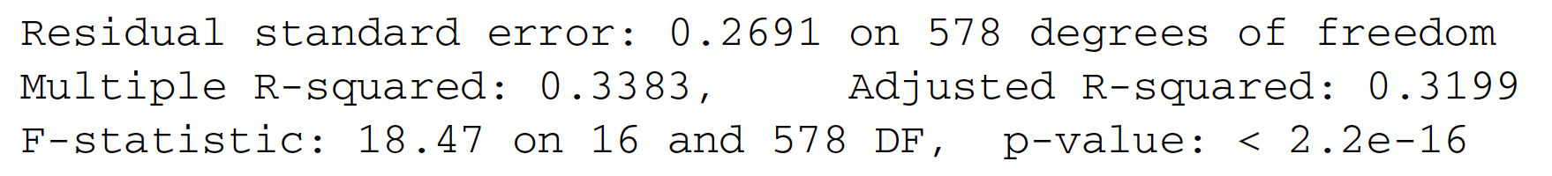
Overall model quality summary
degrees of freedom : the number of training data rows you have after correcting for the number of coefficients you tried to solve
# of data rows - # of coefficients fit
df <- dim(dtrain)[1] - dim(summary(model)$coefficients)[1]
residual standard error
sum of the square of the residuals divided by the degrees of freedom
modelResidualError <- sqrt(sum(residuals(model)^2)/df)
Practical Data Science with R by Nina Zumel, John Mount

Slide 94
Overall Model Quality Summary
Multiple R-squared : R-squared
Adjusted R-squared : correct that more complex models tend to look better on training data due to overfitting
R-squared penalized by the ratio of the degrees of freedom to the number of training examples.
Practical Data Science with R by Nina Zumel, John Mount

Slide 95
Is There a Relationship Between the Response and Predictors?
whether the linear regression model predicts outcome better than the constant mode (the mean value of y)
Null hypothesis
H₀: β₁ = β₂ = … = β_{p}= 0
Alternative hypothesis
H_{a}: at least one β_{j} is non-zero.
Practical Data Science with R by Nina Zumel, John Mount

Slide 96

F-statistic
$F=\frac{{\left(\text{TSS}−\text{RSS}\right)}/p}{{\text{RSS}}/{\left(n−p−1\right)}}$
If the linear model assumptions are correct, $E\left\{{RSS}/{\left(n−p−1\right)}\right\}=σ^{2}$
if H₀ is true, $E\left\{{\left(TSS−RSS\right)}/p\right\}=σ^{2}$
F-statistic close to 1
if H_{a} is true, $E\left\{{\left(TSS−RSS\right)}/p\right\}>σ^{2}$
F-statistic greater than 1
An Introduction to Statistical Learning with Applications in R by Gareth James, Daniela Witten, Trevor Hastie, Robert Tibshirani

Slide 97

F-statistic @ Sales example
F-statistic is 570.
Since this is far larger than 1
=> against the null hypothesis H₀
=> at least one of the advertising media must be related to sales
An Introduction to Statistical Learning with Applications in R by Gareth James, Daniela Witten, Trevor Hastie, Robert Tibshirani

Slide 98
Given individual p-values for each variable, why need the overall F-statistic?
Given
p = 100 (the number of predictors)
H₀: β₁ = β₂ =…= β_{p} = 0 is true (no variable is truly associated with the response)
5%: the p-values associated with each variable will be below 0.05 by chance
expect to see ~5 small p-values even no true association between the predictors and the response
if H₀ is true, there is only a 5% chance that the F-statistic will result in a p-value below 0.05, regardless of the number of predictors or the number of observations
F-statistic adjusts for p
An Introduction to Statistical Learning with Applications in R by Gareth James, Daniela Witten, Trevor Hastie, Robert Tibshirani

Slide 99
F-statistic limit
p certainly small compared to n
If p > n, then there are more coefficients β_{j} to estimate than observations from which to estimate them
Cannot even fit the multiple linear regression model using least squares
F-statistic cannot be used
high-dimensional setting use forward selection
An Introduction to Statistical Learning with Applications in R by Gareth James, Daniela Witten, Trevor Hastie, Robert Tibshirani

Slide 100
Other Considerations in the Regression Model

Slide 101

Qualitative Predictors
balance vs. Ethnicity
Asian
Caucasian
African American
create two dummy variables, x_{i1}& x_{i2}
$y_{i}=β_{0}+β_{1}x_{i1}+β_{2}x_{i2}+ε_{i}=\left\{\begin{aligned}β_{0}+β_{1}+ε_{i},\text{if} \text{i}\text{th} \text{person} \text{is} \text{Asian} \\ β_{0}+β_{2}+ε_{i},\text{if} \text{i}\text{th} \text{person} \text{is} \text{Caucasian} \\ β_{0}+ε_{i},\text{if} \text{i}\text{th} \text{person} \text{isAfrican} \text{American}\end{aligned}\right.$
An Introduction to Statistical Learning with Applications in R by Gareth James, Daniela Witten, Trevor Hastie, Robert Tibshirani

Slide 102

Least squares coefficient estimates associated with the regression of balance onto ethnicity in the Credit data set
Baseline: African American
Balance = $531. 00
Asian: have $18.69 less debt than the African American category, no significant
Caucasian: have $12.50 less debt than the African American, no significant
F-test to H₀: β₁ = β₂ = 0 => p-value = 0. 96
An Introduction to Statistical Learning with Applications in R by Gareth James, Daniela Witten, Trevor Hastie, Robert Tibshirani

Slide 103
Extensions of the Linear Model
2 most important assumption of linear model
Additive
the effect of changes in a predictor X_{j} on the response Y is independent of the values of the other predictors
Linear:
the change in the response Y due to a one-unit change in X_{j} is constant, regardless of the value of X_{j}

Slide 104

Removing the Additive Assumption
Only main effects
$Y=β_{0}+β_{1}X_{1}+β_{1}X_{2}+ε$
$\text{Sales}=β_{0}+β_{1}\text{TV}+β_{1}\text{radio}+ε$
synergy effect, interaction
$Y=β_{0}+β_{1}X_{1}+β_{1}X_{2}+β_{3}X_{1}X_{2}+ε$
$\text{Sales}=β_{0}+β_{1}\text{TV}+β_{1}\text{radio}+β_{3}\text{TV}×\text{radio}+ε$
An Introduction to Statistical Learning with Applications in R by Gareth James, Daniela Witten, Trevor Hastie, Robert Tibshirani

Slide 105


Removing the Additive Assumption
$\text{Sales}=6.7502+0.0191\text{TV}+0.0289\text{radio}+0.0011\text{TV}×\text{radio}+ε$
increase in TV advertising of $1, 000
$\text{Sales}=6.7502+(0.0191\text{+0.0011}\text{radio}\text{)}\text{TV}+0.0289\text{radi}\text{o}+ε$
19+1.1radio units in sales
An Introduction to Statistical Learning with Applications in R by Gareth James, Daniela Witten, Trevor Hastie, Robert Tibshirani

Slide 106
Removing the Additive Assumption
R²
the interaction model = 96.8%,
only main effects = 89.7%
69% = (96.8− 89.7)/(100−89.7)
the variability in sales that remains after fitting the additive model has been explained by the interaction term

Slide 107
The hierarchical principle
If we include an interaction in a model, we should also include the main effects, even if the p-values associated with their coefficients are not significant
An Introduction to Statistical Learning with Applications in R by Gareth James, Daniela Witten, Trevor Hastie, Robert Tibshirani

Slide 108

Non-linear Relationships
Figure 3.8, An Introduction to Statistical Learning with Applications in R by Gareth James, Daniela Witten, Trevor Hastie, Robert Tibshirani

Slide 109


Polynomial regression
Add quadratic
$\text{mpg}=β_{0}+β_{1}\text{horsepower}+β_{2}{\text{horsepower}}^{2}+ε$
R²
the quadratic fit = 0 .688
the linear fit = 0 .606
An Introduction to Statistical Learning with Applications in R by Gareth James, Daniela Witten, Trevor Hastie, Robert Tibshirani

Slide 110
Non-linear Relationships
horsepower²
horsepower²+horsepower³+horsepower⁴+horsepower⁵
Figure 3.8, An Introduction to Statistical Learning with Applications in R by Gareth James, Daniela Witten, Trevor Hastie, Robert Tibshirani

Slide 111

Non-linearity of the Data
U-shape
little pattern
Figure 3.9, An Introduction to Statistical Learning with Applications in R by Gareth James, Daniela Witten, Trevor Hastie, Robert Tibshirani

Slide 112

Correlation of Error Terms
$ε_{1},ε_{2}$,…,$ε_{n}$are uncorrelated.
If they are correlated?
we accidentally doubled our data, leading to observations and error terms identical in pairs
Our standard error calculations would be as if we had a sample of size 2n, when in fact we have only n samples
confidence intervals will be bias narrower by $\sqrt{2}$
An Introduction to Statistical Learning with Applications in R by Gareth James, Daniela Witten, Trevor Hastie, Robert Tibshirani

Slide 113



Non-constant Variance of Error Terms
the error terms have a constant variance
$Var\left(ε_{i}\right)=σ^{2}$
non-constant variances in the errors
a funnel shape in the residual plot
$$\text{log}Y \text{or} \sqrt{y}$$
Figure 3.11, An Introduction to Statistical Learning with Applications in R by Gareth James, Daniela Witten, Trevor Hastie, Robert Tibshirani

Slide 114

Outliers
Without outlier 20 vs with outlier 20
R²: 0.892 vs 0 .805
RSE: 1.09 vs 0.77
Studentized residuals
Observations whose absolute studentized residuals >= 3 : possible outliers.
Figure 3.12, An Introduction to Statistical Learning with Applications in R by Gareth James, Daniela Witten, Trevor Hastie, Robert Tibshirani

Slide 115

High Leverage Points
Observations with unusual value for x_{i}
Figure 3.13, An Introduction to Statistical Learning with Applications in R by Gareth James, Daniela Witten, Trevor Hastie, Robert Tibshirani

Slide 116

High Leverage Points in multiple regression setting
The red observation is not unusual in terms of its X₁ value or its X₂ value, but still falls outside the bulk of the data, and hence has high leverage.
Figure 3.13, An Introduction to Statistical Learning with Applications in R by Gareth James, Daniela Witten, Trevor Hastie, Robert Tibshirani

Slide 117


Leverage statistic
$h_{i}=\frac{1}{n}+\frac{{\left(x_{i}−\overline{x}\right)}^{2}}{\sum_{i^{′}=1}^{n}{{\left(x_{i^{′}}−\overline{x}\right)}^{2}}}$
range: 1/n ~ 1
average = (p+1)/n
high leverage : greatly exceeds (p+1)/n
Figure 3.13, An Introduction to Statistical Learning with Applications in R by Gareth James, Daniela Witten, Trevor Hastie, Robert Tibshirani

Slide 118

Collinearity
Contour plots for the RSS
0.15 ~ 0.20
-0.2 ~ 0.2
Figure 3.15, An Introduction to Statistical Learning with Applications in R by Gareth James, Daniela Witten, Trevor Hastie, Robert Tibshirani

Slide 119

Collinearity reduce detecting power
Since collinearity reduces the accuracy of the estimates of the regression coefficients
the standard error for $\hat{β_{j}}$ grow
t-statistic for each predictor: dividing $\hat{β_{j}}$ by its standard error => a decline in the t-statistic.
we may fail to reject H₀: β_{j} = 0
the probability of correctly power detecting a non-zero coefficient is reduced
An Introduction to Statistical Learning with Applications in R by Gareth James, Daniela Witten, Trevor Hastie, Robert Tibshirani

Slide 120

Collinearity reduce detecting power
An Introduction to Statistical Learning with Applications in R by Gareth James, Daniela Witten, Trevor Hastie, Robert Tibshirani

Slide 121

Detect collinearity
correlation matrix
multicollinearity
variance inflation factor
$\text{VIF}\left(\hat{β_{i}}\right)=\frac{1}{1−R_{x_{i}|x_{−i}}^{2}}$, where $R_{x_{i}|x_{−i}}^{2}$ is R² from a regression of X_{i} onto all of the other predictors
age, rating, and limit with VIF values = 1.01, 160.67, and 160.59
An Introduction to Statistical Learning with Applications in R by Gareth James, Daniela Witten, Trevor Hastie, Robert Tibshirani

Slide 122
Solution for collinearity
drop one of the problematic variables from the regression
balance onto age and limit, without rating
combine the collinear variables together into a single predictor
a new variable, credit worthiness: the average of of limit and rating
An Introduction to Statistical Learning with Applications in R by Gareth James, Daniela Witten, Trevor Hastie, Robert Tibshirani

Slide 123
Summary with the previous marketing plan

Slide 124
Is there a relationship between advertising sales and budget?
Sales = β₀ + β₁TV + β₂radio + β₃newspaper + ε
F-statistic test the hypothesis
H₀: β₁ = β₂ = β₃ = 0
the p-value corresponding to the F-statistic, 570, is very low
Reject null hypothesis
Clear evidence of a relationship between advertising and sales.
An Introduction to Statistical Learning with Applications in R by Gareth James, Daniela Witten, Trevor Hastie, Robert Tibshirani

Slide 125
How strong is the relationship?
RSE: the standard deviation of the response from the population regression line
1681 units, the mean value for the response=14022 => percentage error of roughly 12%
R²: the percentage of variability in the response that is explained by the predictors
0.897: almost 90% of the variance in sales
An Introduction to Statistical Learning with Applications in R by Gareth James, Daniela Witten, Trevor Hastie, Robert Tibshirani

Slide 126

Which media contribute to sales?
the p-values associated with each predictor’s t-statistic
An Introduction to Statistical Learning with Applications in R by Gareth James, Daniela Witten, Trevor Hastie, Robert Tibshirani

Slide 127

How large is the effect of each medium on sales?
the standard error of $\hat{β_{i}}$ can be used to construct confidence intervals for $β_{i}$
the 95% confidence intervals
TV: (0.043, 0.049)
Radio: (0.172, 0.206)
TV & radio narrow and far from zero => related to sales
Newspaper: (−0.013, 0.011)
includes zero, not statistically significant given the values of TV & radio
An Introduction to Statistical Learning with Applications in R by Gareth James, Daniela Witten, Trevor Hastie, Robert Tibshirani

Slide 128
How large is the effect of each medium on sales?
Could collinearity be the reason that the confidence interval associated with newspaper is so wide?
VIF scores:
TV: 1. 005
Radio: 1. 145
Newspaper: 1. 145
no evidence of collinearity
An Introduction to Statistical Learning with Applications in R by Gareth James, Daniela Witten, Trevor Hastie, Robert Tibshirani

Slide 129
How large is the effect of each medium on sales?
three separate simple linear regressions
An Introduction to Statistical Learning with Applications in R by Gareth James, Daniela Witten, Trevor Hastie, Robert Tibshirani

Slide 130

How accurately can we predict future sales?
predict an individual response, Y = f(X) + $ε$
prediction interval
the average response, f(X)
confidence interval
Prediction intervals will always be wider than confidence intervals because they account for the uncertainty associated with $ε$, the irreducible error.
An Introduction to Statistical Learning with Applications in R by Gareth James, Daniela Witten, Trevor Hastie, Robert Tibshirani

Slide 131

Is the relationship linear?
the residual plots should display no pattern => linear relationship
Figure 3.5, An Introduction to Statistical Learning with Applications in R by Gareth James, Daniela Witten, Trevor Hastie, Robert Tibshirani

Slide 132
Is there synergy among the advertising media?
p-value associated with the interaction term
R²: ~90% to almost 97%, including an interaction term in the model
An Introduction to Statistical Learning with Applications in R by Gareth James, Daniela Witten, Trevor Hastie, Robert Tibshirani

Slide 133
Comparison of Linear Regression with K-Nearest Neighbors

Slide 134
A parametric approach: a linear functional form for f(X)
non-parametric: do not explicitly assume a parametric form for f(X)
K-nearest neighbors regression (KNN-regression)
An Introduction to Statistical Learning with Applications in R by Gareth James, Daniela Witten, Trevor Hastie, Robert Tibshirani

Slide 135

The KNN regression
Given a value for K and a prediction point x₀
identifies the K training observations that are closest to x₀, represented by N₀
estimates f(x₀) using the average of all the training responses in N₀
$\hat{f}\left(x_{0}\right)=\frac{1}{K}\sum_{x_{i∈N_{0}}}{y_{i}}$
An Introduction to Statistical Learning with Applications in R by Gareth James, Daniela Witten, Trevor Hastie, Robert Tibshirani

Slide 136


Plots of $\hat{f}\left(x\right)$using KNN regression on a two-dimensional data
Figure 3.16, An Introduction to Statistical Learning with Applications in R by Gareth James, Daniela Witten, Trevor Hastie, Robert Tibshirani

Slide 137

When least squares linear regression outperform KNN regression?
the parametric approach will outperform the nonparametric approach if the parametric form that has been selected is close to the true form of f.
Figure 3.18, An Introduction to Statistical Learning with Applications in R by Gareth James, Daniela Witten, Trevor Hastie, Robert Tibshirani

Slide 138

KNN performs better than linear regression
Figure 3.19, An Introduction to Statistical Learning with Applications in R by Gareth James, Daniela Witten, Trevor Hastie, Robert Tibshirani

Slide 139

Curse of dimensionality
spreading 100 observations over 20 dimensions
additional noise p predictors
Figure 3.20, An Introduction to Statistical Learning with Applications in R by Gareth James, Daniela Witten, Trevor Hastie, Robert Tibshirani

Slide 140
Observation ~ predictor
This decrease in performance as the dimension increases is a common problem for KNN
Parametric methods will tend to outperform non-parametric approaches when there is a small number of observations per predictor
The dimension is small, we might prefer linear regression to KNN from an interpretability standpoint.
An Introduction to Statistical Learning with Applications in R by Gareth James, Daniela Witten, Trevor Hastie, Robert Tibshirani

Slide 141
Summary
Linear regression is the go-to statistical modeling method for quantities.
You should always try linear regression first, and only use more complicated methods if they actually outperform a linear regression model.
Linear regression will have trouble with problems that have a very large number of variables, or categorical variables with a very large number of levels.
You can enhance linear regression by adding new variables or transforming variables
like we did with the log() transform of y , but always be wary when transforming y as it changes the error model.
Practical Data Science with R by Nina Zumel, John Mount

Slide 142
Summary
With linear regression, you think in terms of residuals. You look for variables that correlate with your errors and add them to try and eliminate systematic modeling errors.
Linear regression can predict well even in the presence of correlated variables, but correlated variables lower the quality of the advice.
Overly large coefficient magnitudes, overly large standard errors on the coefficient estimates, and the wrong sign on a coefficient could be indications of correlated inputs.
Linear regression packages have some of the best built-in diagnostics available, but rechecking your model on test data is still your most effective safety check.
Practical Data Science with R by Nina Zumel, John Mount

Slide 143

Thank You Any Question?

